Slide 1
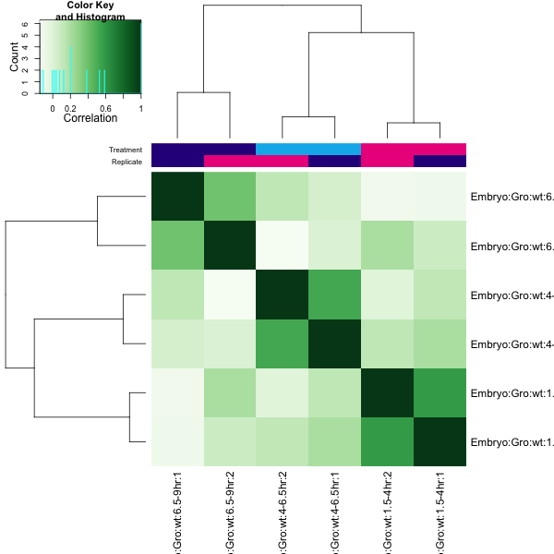
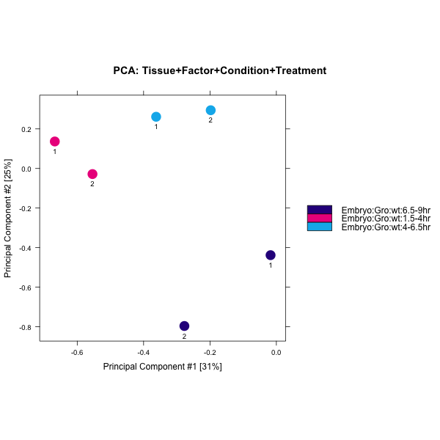
A
B
4 – 6.5 hr
6.5 – 9 hr
4 – 6.5 hr
6.5 – 9 hr
4 – 6.5 hr
6.5 – 9 hr
6.5 – 9 hr
1.5 - 4 hr
1.5 - 4 hr
1.5 - 4hr
4 – 6.5hr
1.5 - 4hr
4 – 6.5 hr
4 – 6.5 hr
6.5 – 9 hr
6.5 – 9 hr
1.5 – 4 hr
1.5 – 4 hr
6.5 – 9 hr
6.5 – 9 hr
4 – 6.5 hr
4 – 6.5 hr
1.5 – 4 hr
1.5 – 4 hr
C

Slide 2
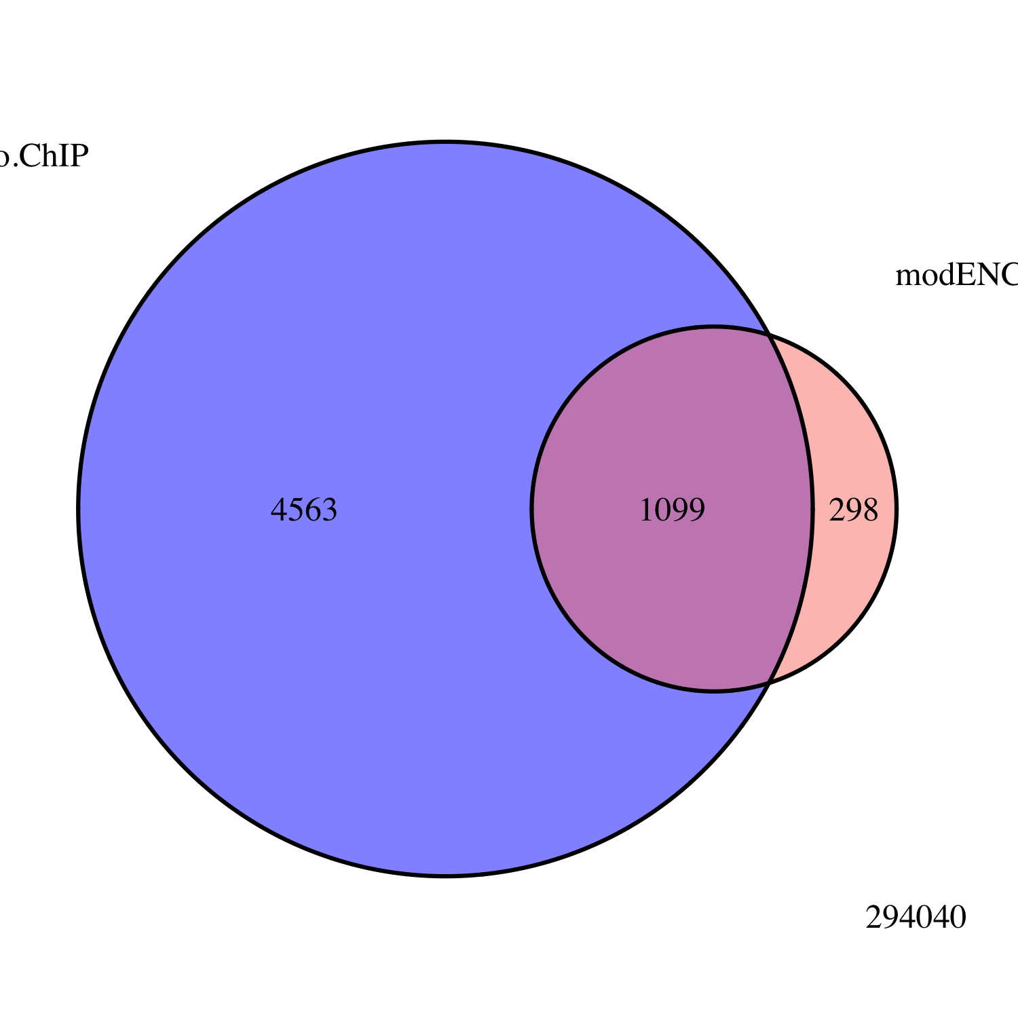
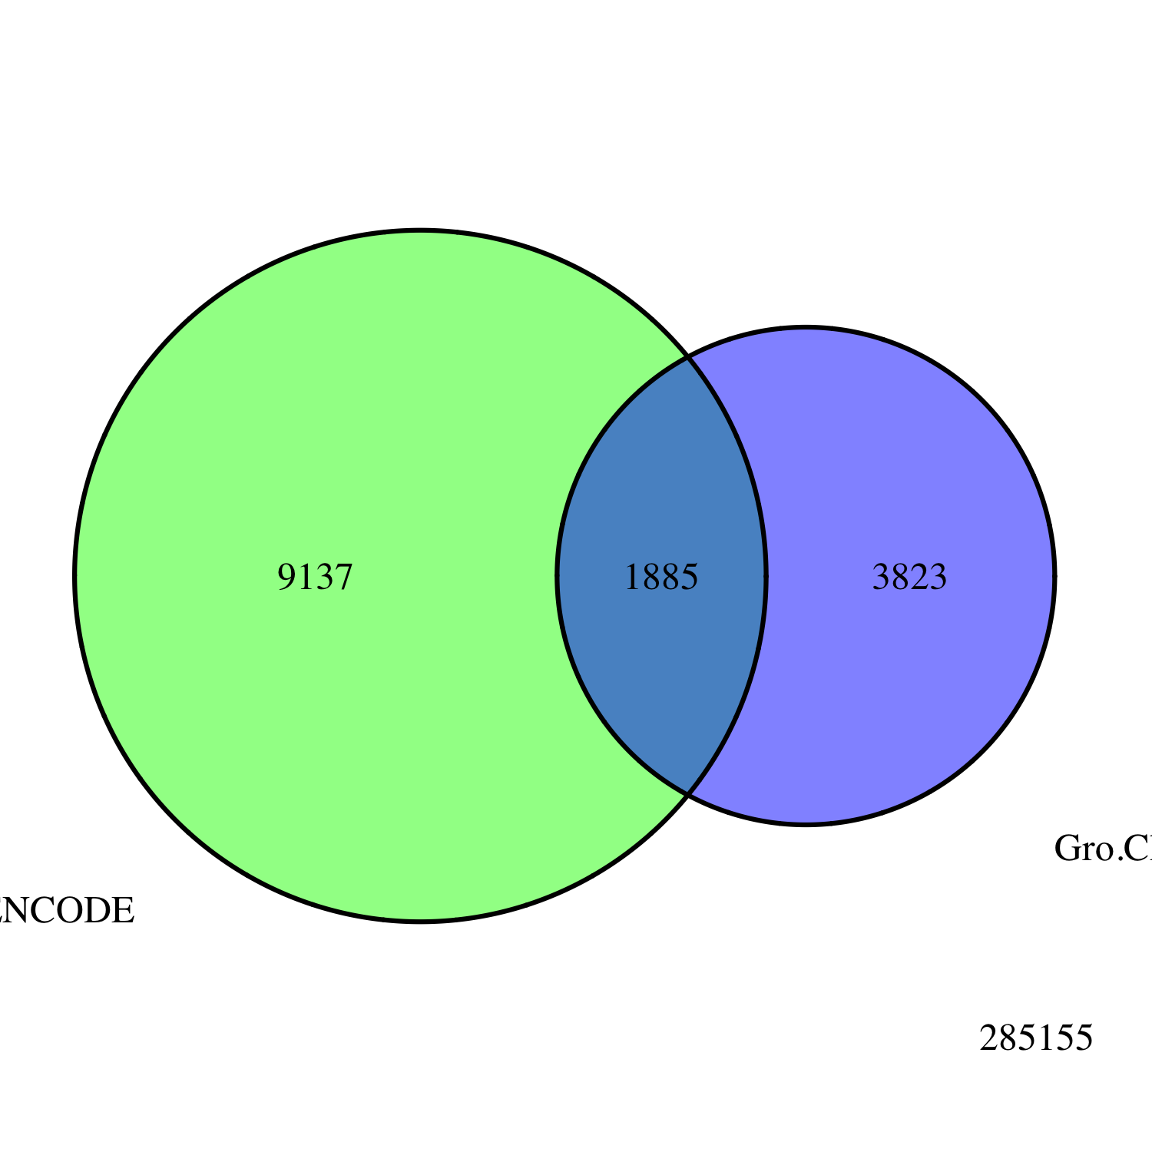
A
Embryo
Gro ChIP-seq
All Peaks
modENCODE
Embryo
Gro ChIP-chip
B
Embryo
Gro ChIP
All Peaks
3823
modENCODE
White Pre-Pupae
Gro ChIP-chip
1885
9137

Slide 3
A
4 – 6.5 hr
B
6.5 – 9 hr
1.5 – 4 hr

Slide 4
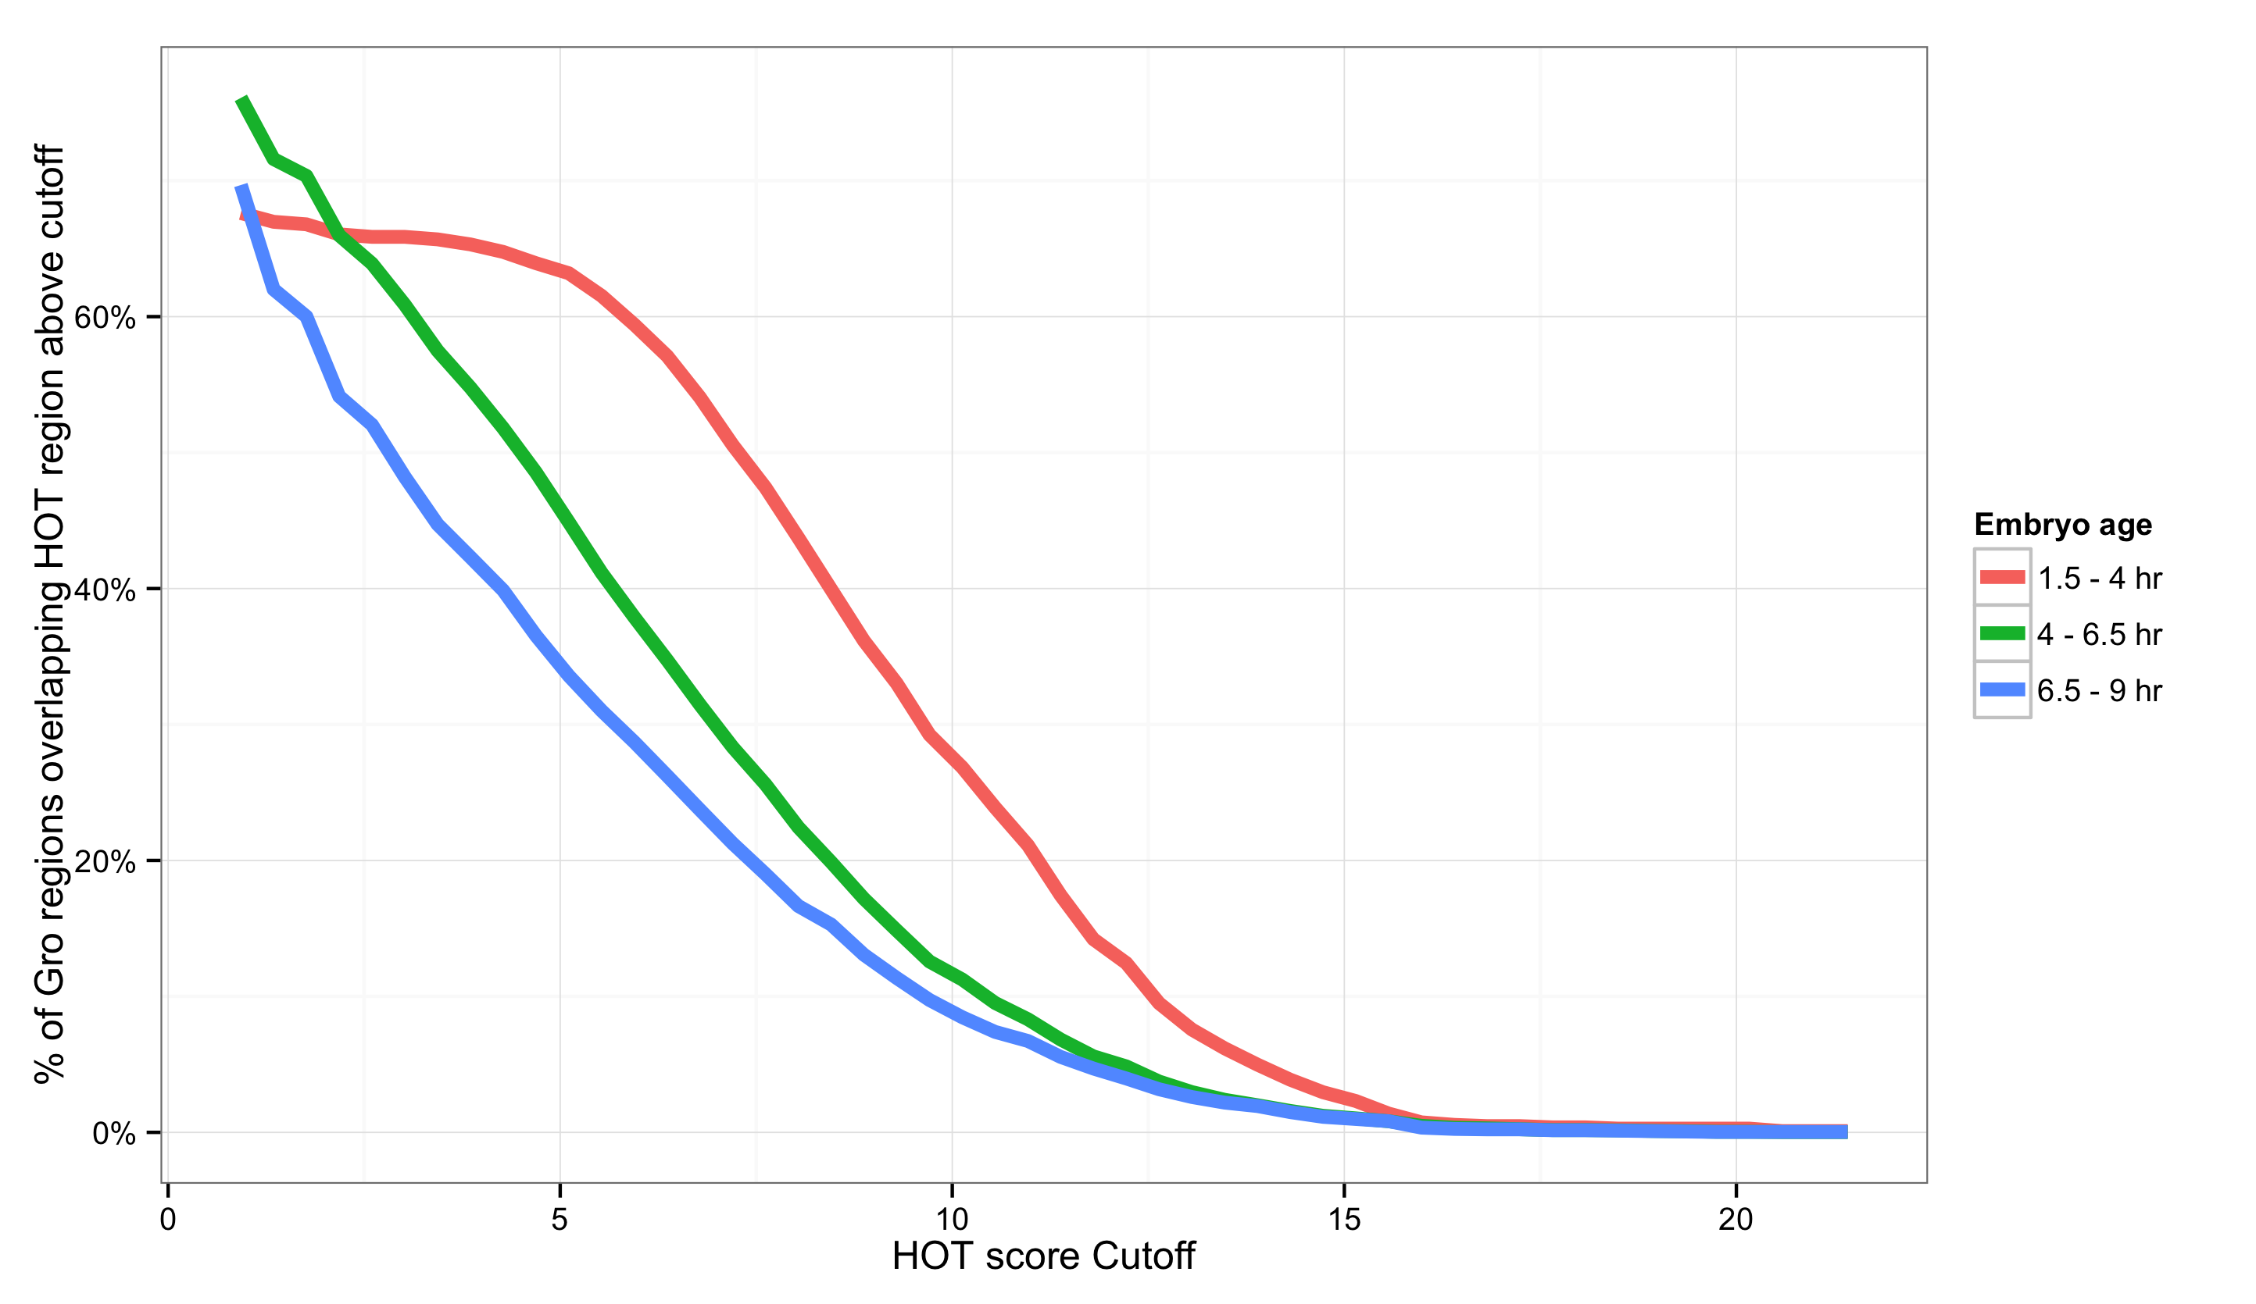
<
<
<
<

Slide 5
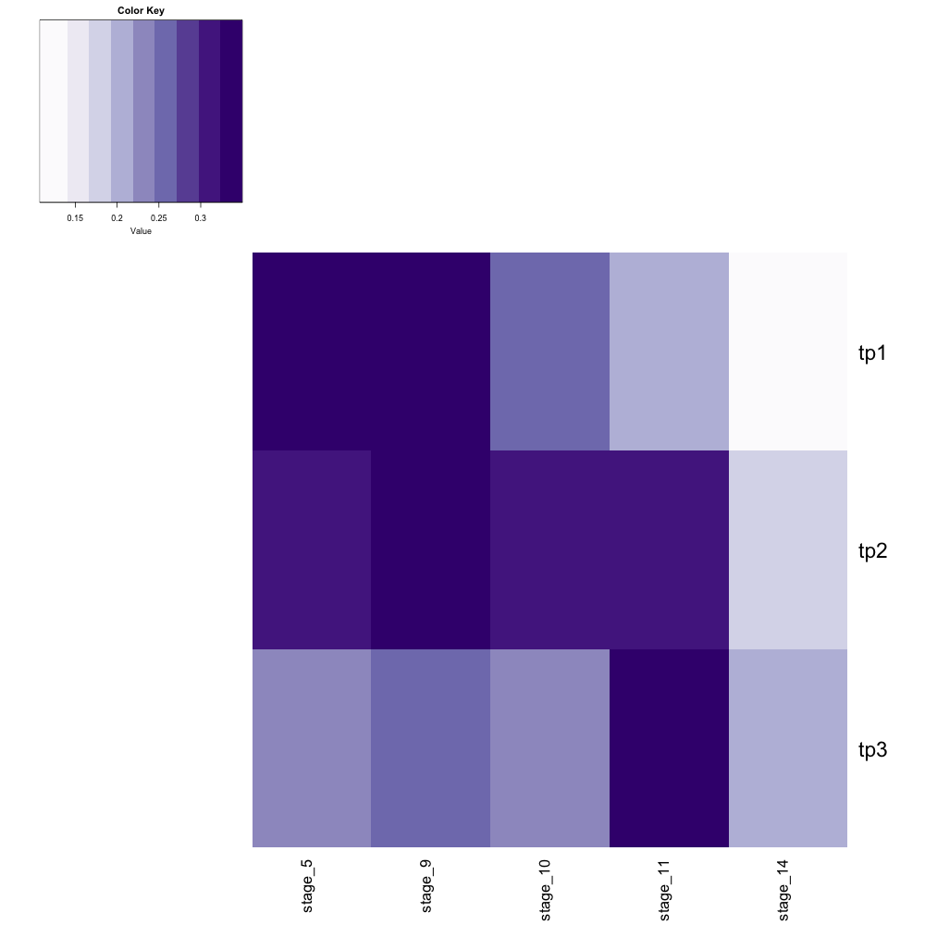

30%
25%
20%
15%
Chromatin accessibility (DNase-seq)
Stage 5
Stage 9
Stage 10
Stage 11
Stage 14
1.5 – 4 hr
Groucho ChIP-seq
4 – 6.5 hr
6.5 – 9 hr
Embryo
age
1.5 – 4 hr
4 – 6.5 hr
6.5 – 9 hr

Slide 6
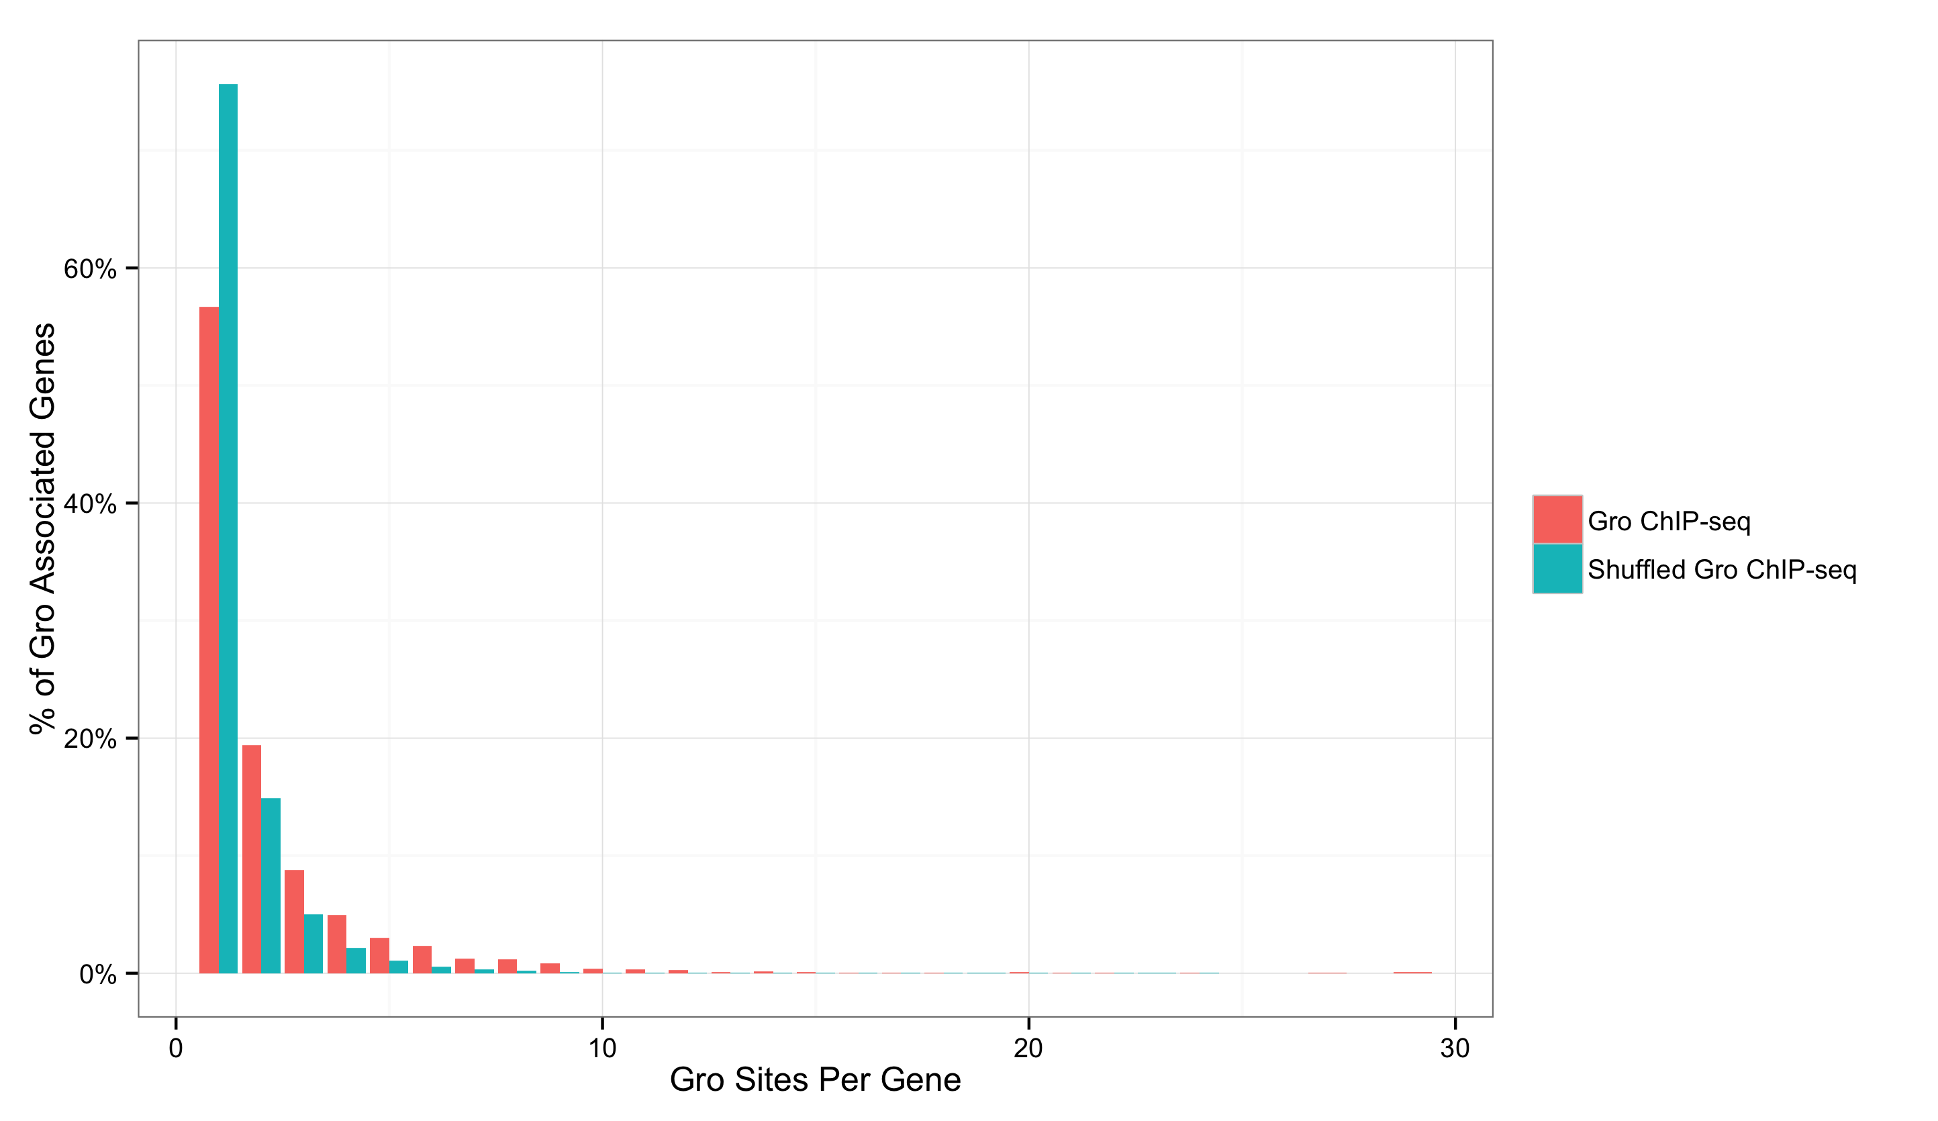
1.5 – 4 hr
4 – 6.5 hr
A
6.5 – 9 hr
B
1
2
3
4
5

Slide 7
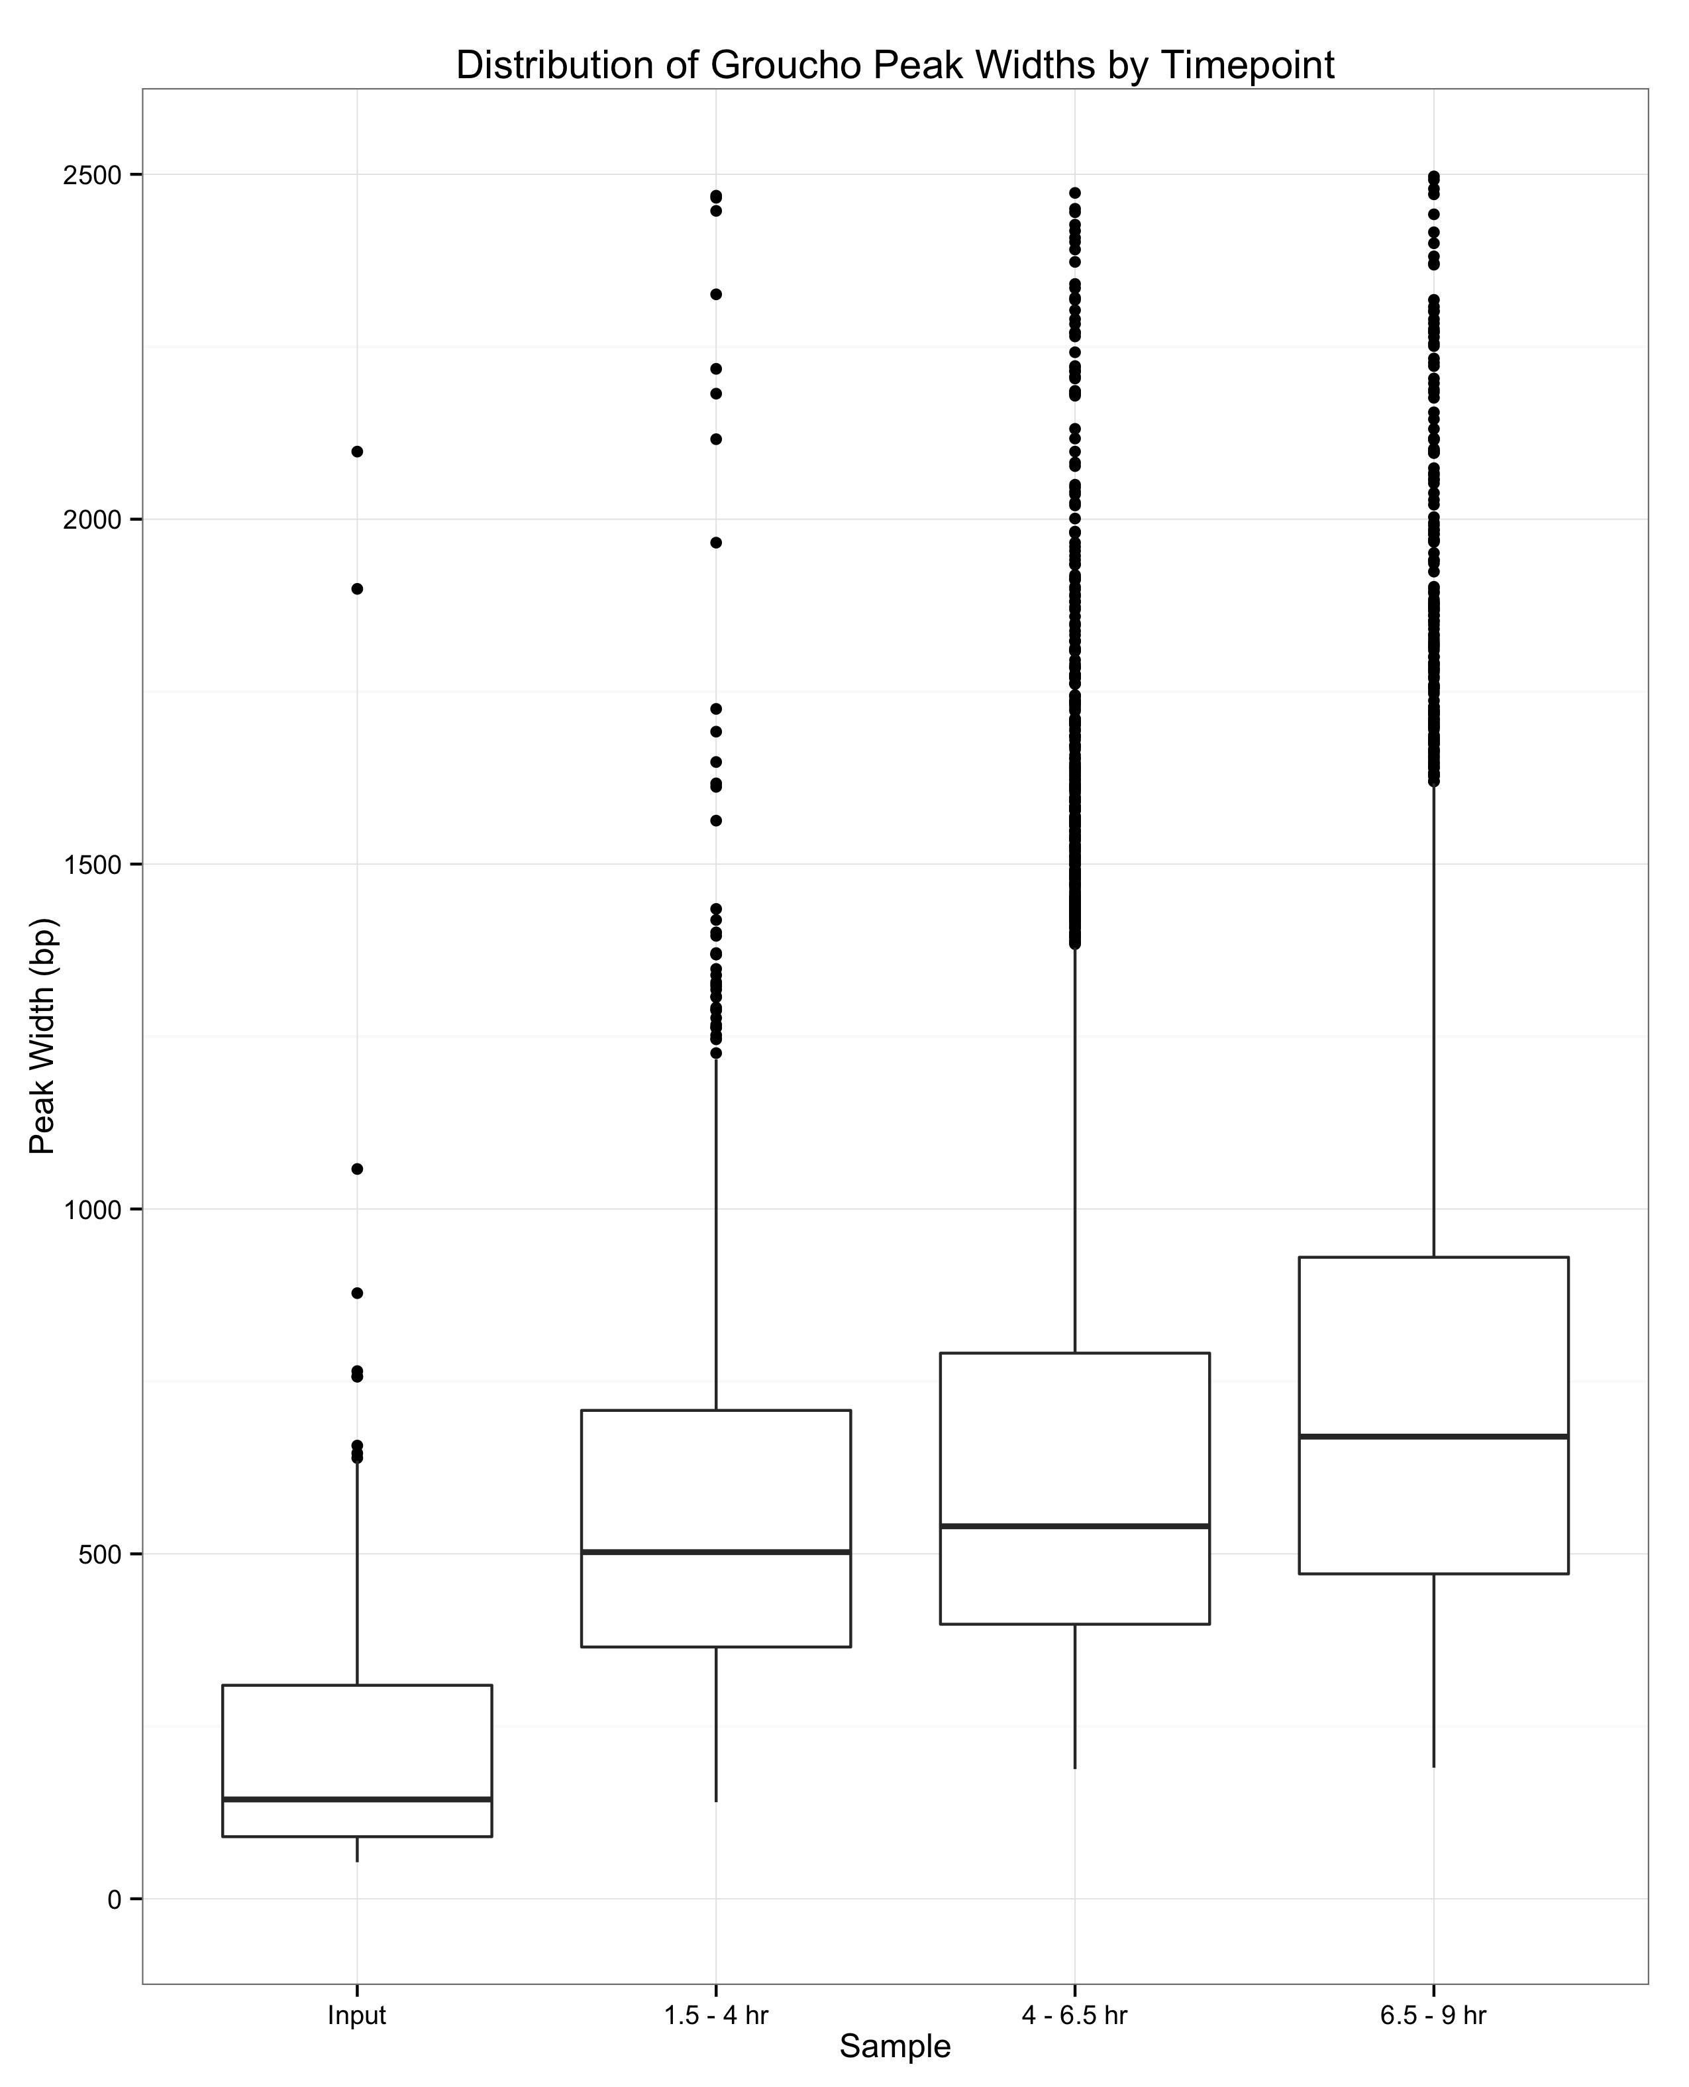

Slide 8
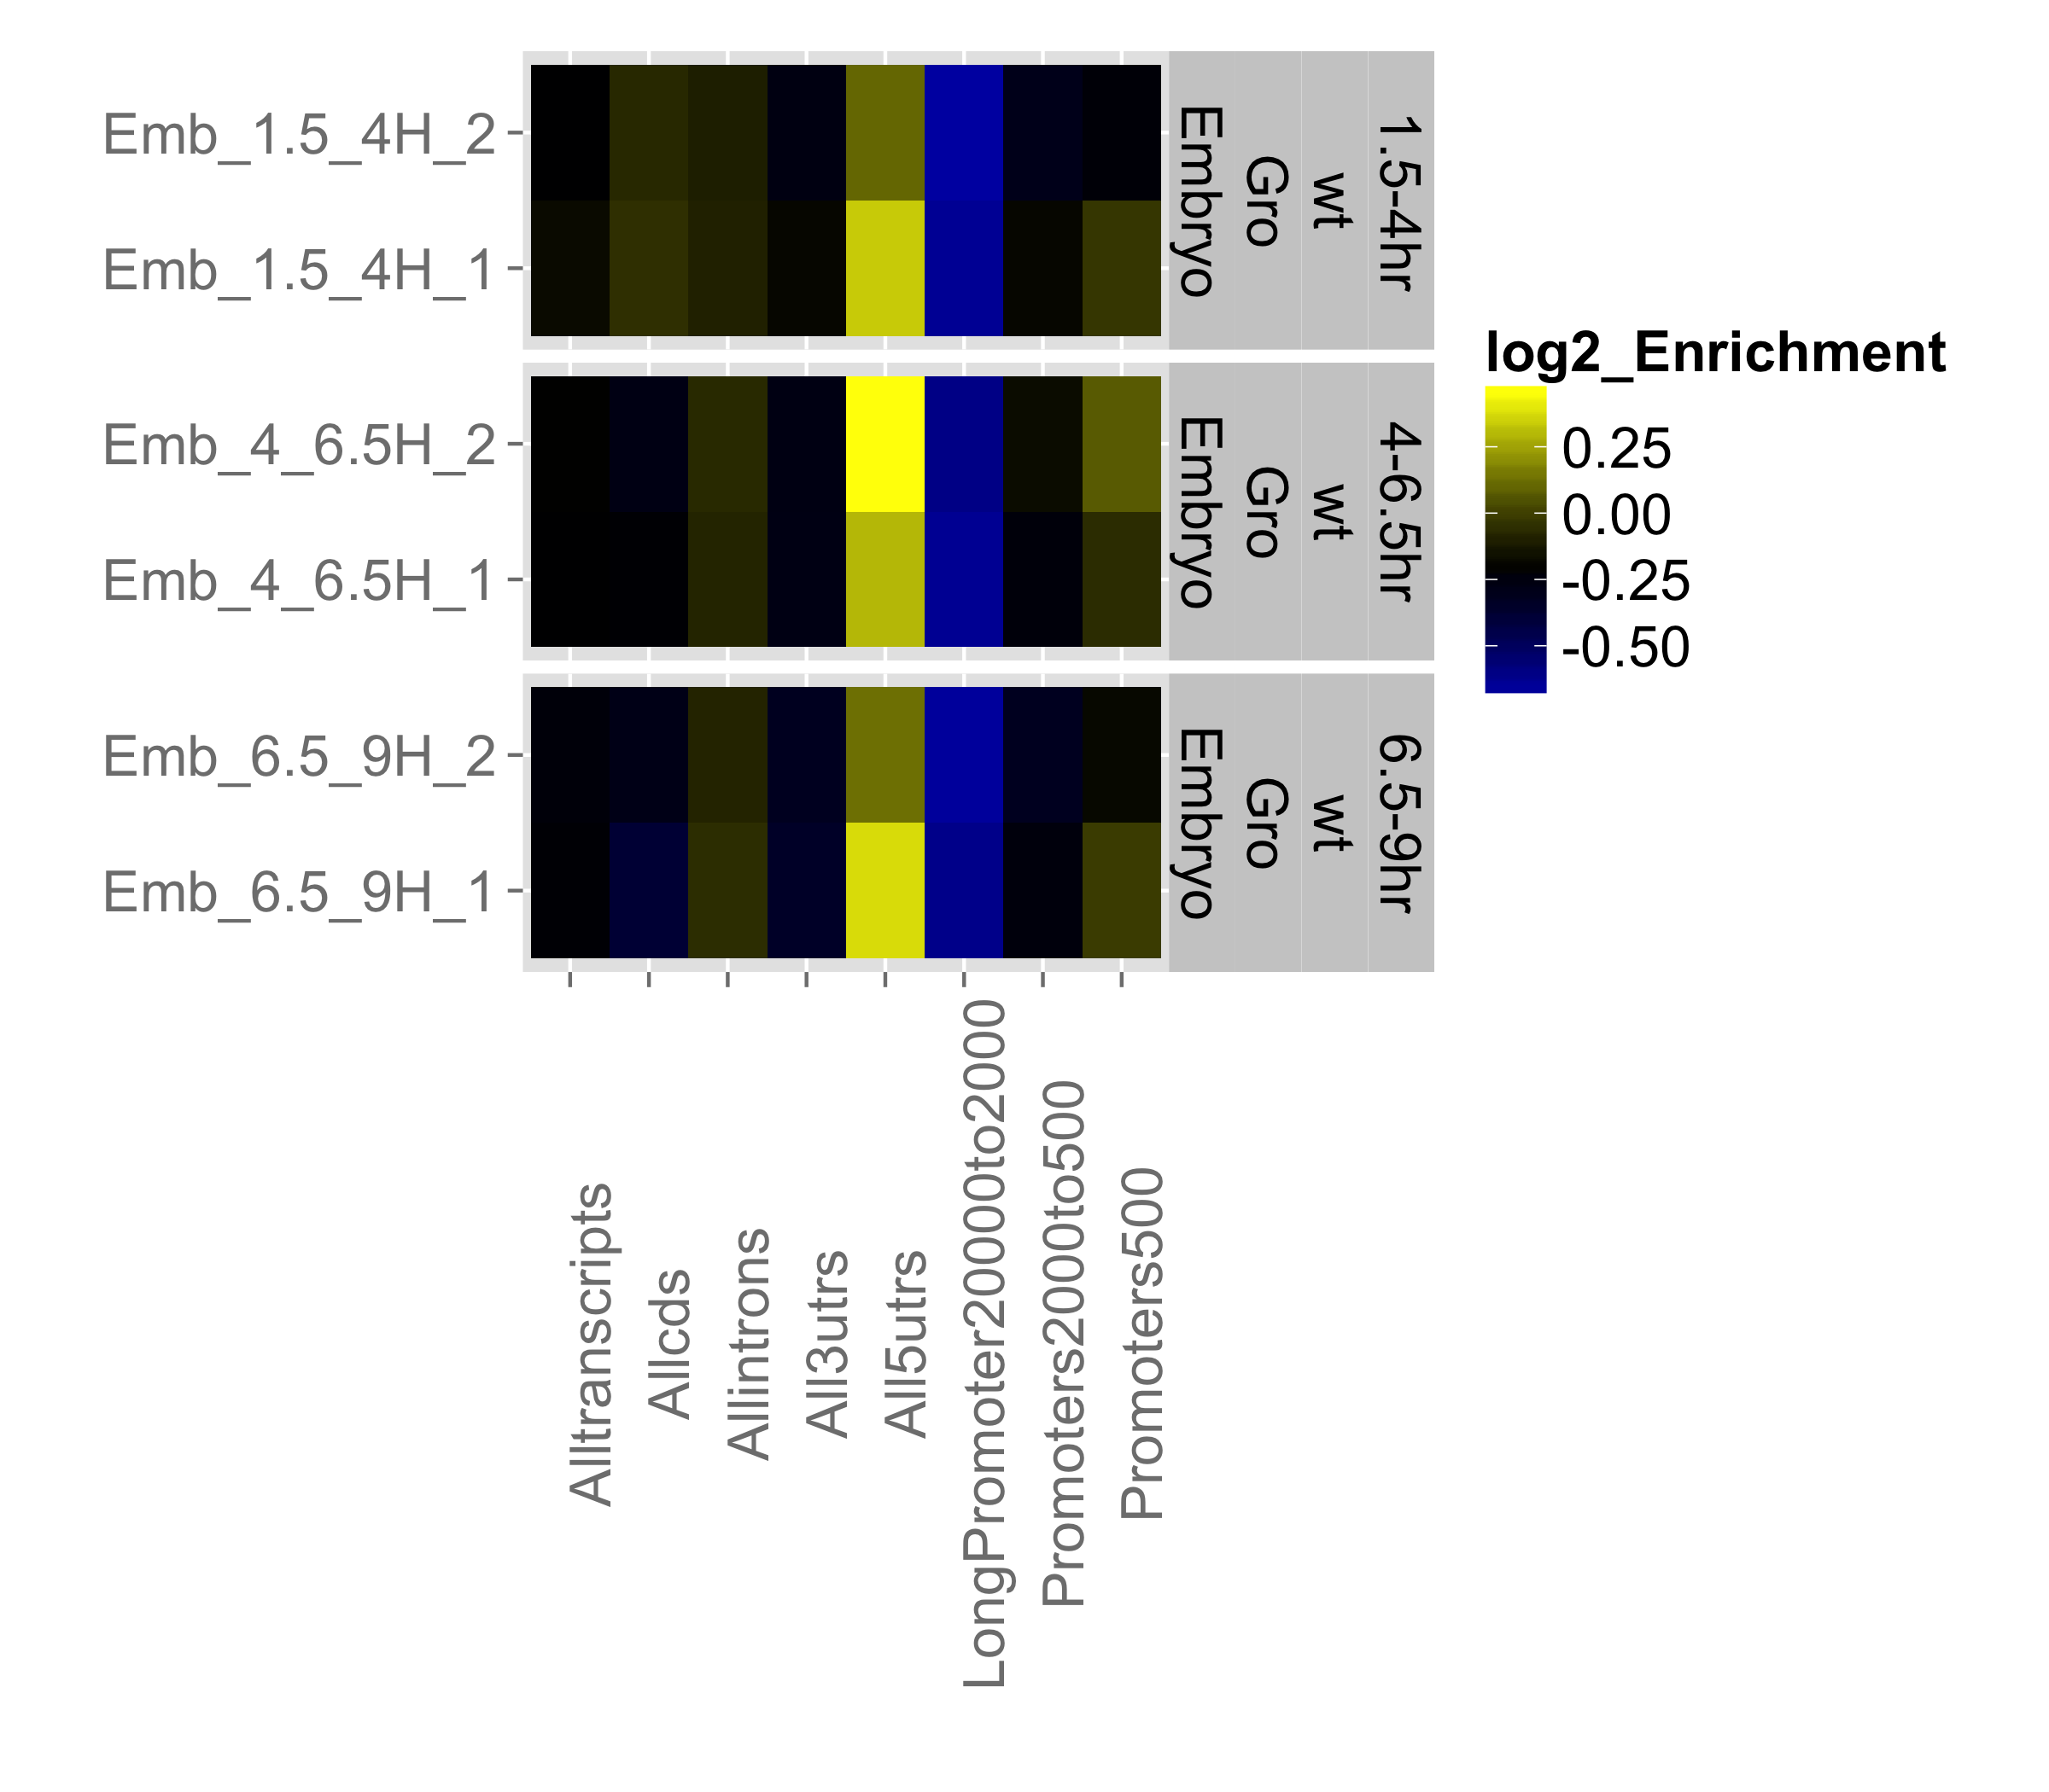
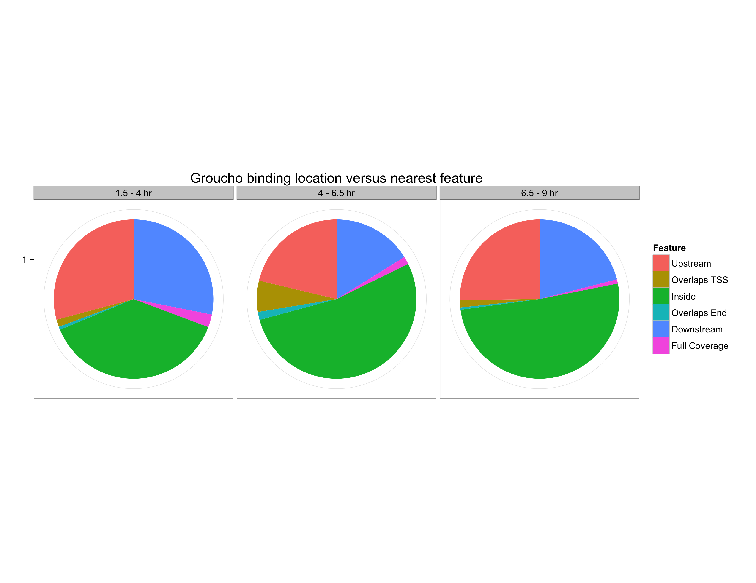
A
Upstream
(bp)
500 to -50
2,000 to 500
20,000 to 2,000
5’ UTR
3’ UTR
Intron
CDS
Transcript
B

Slide 9
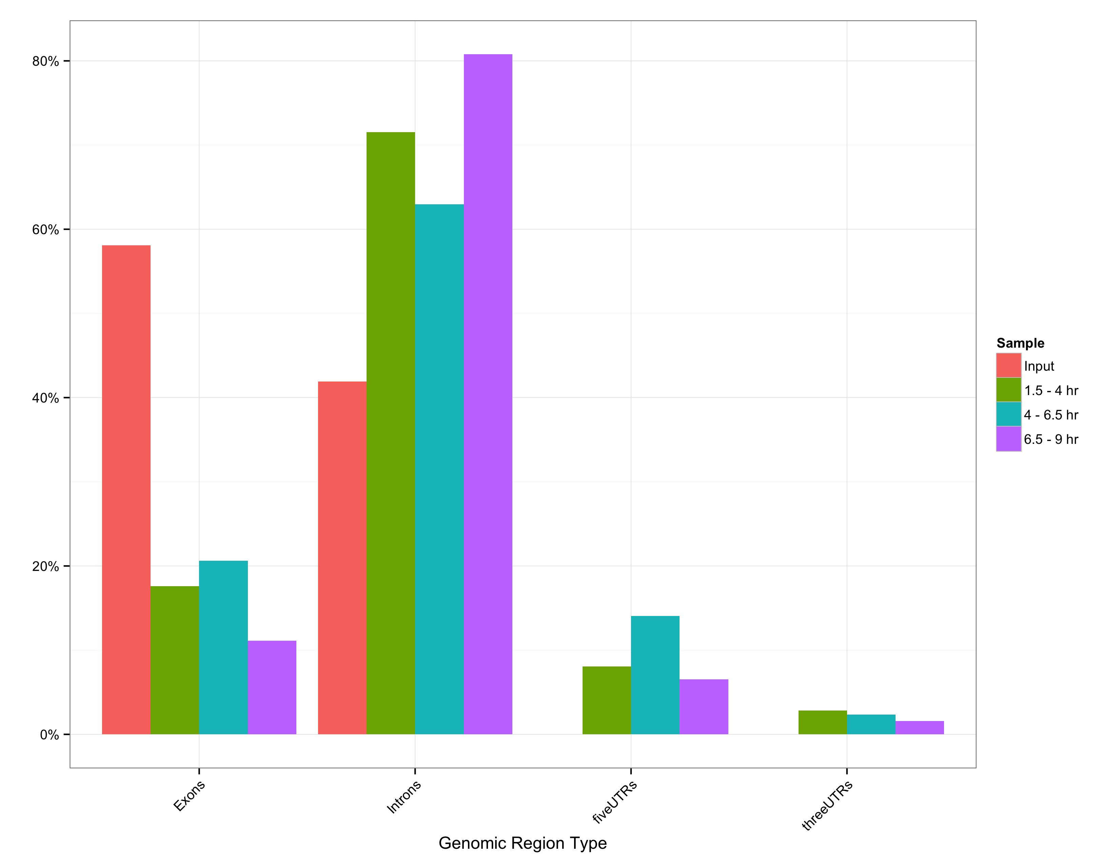
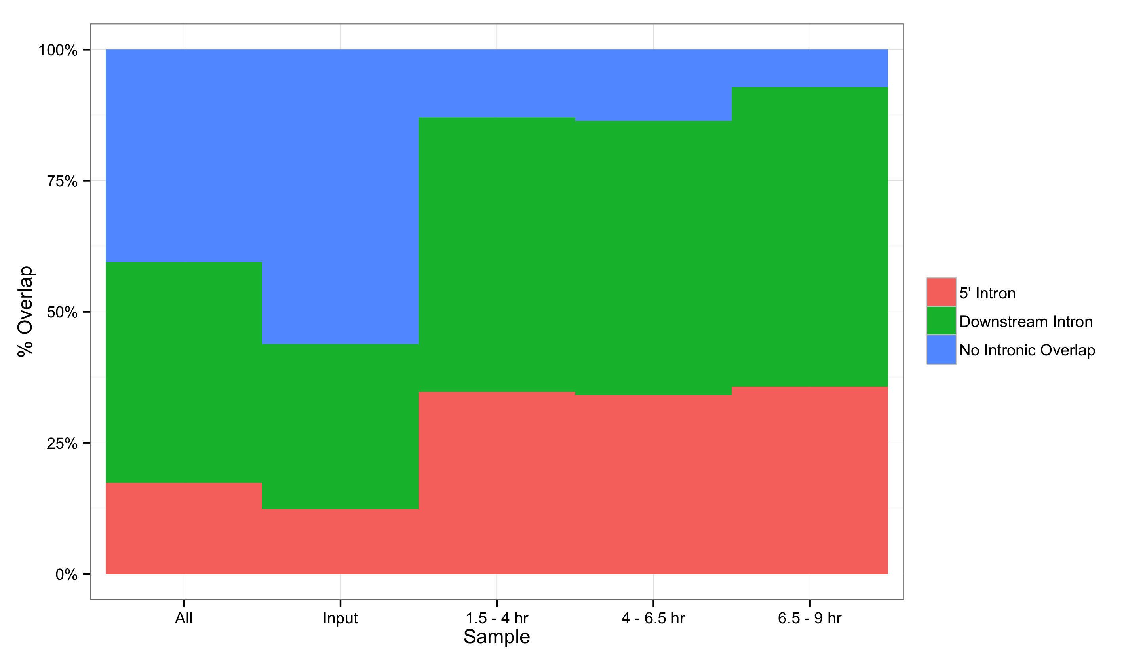
A
B

Slide 10
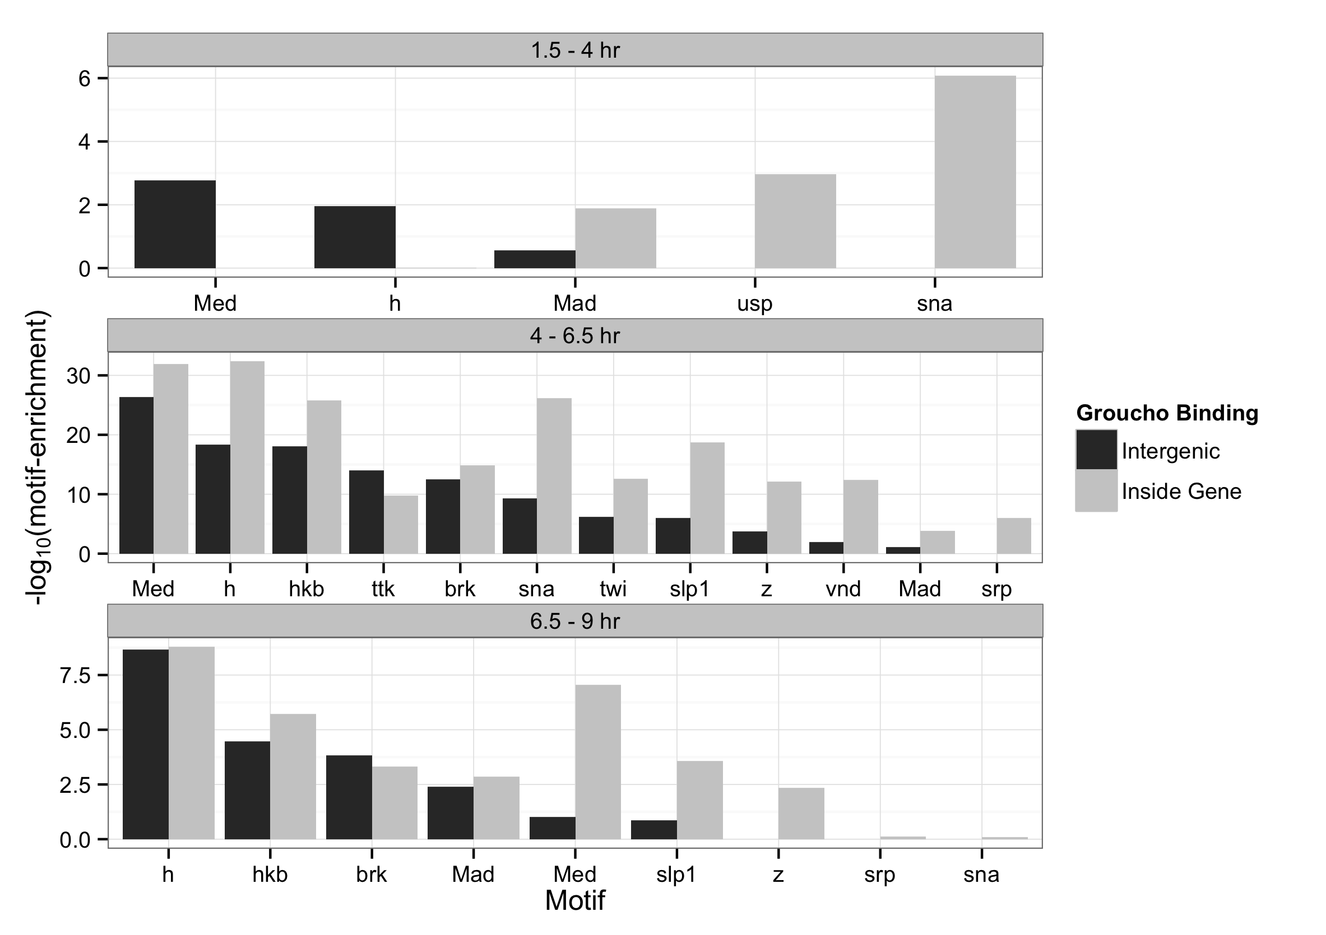

Slide 11
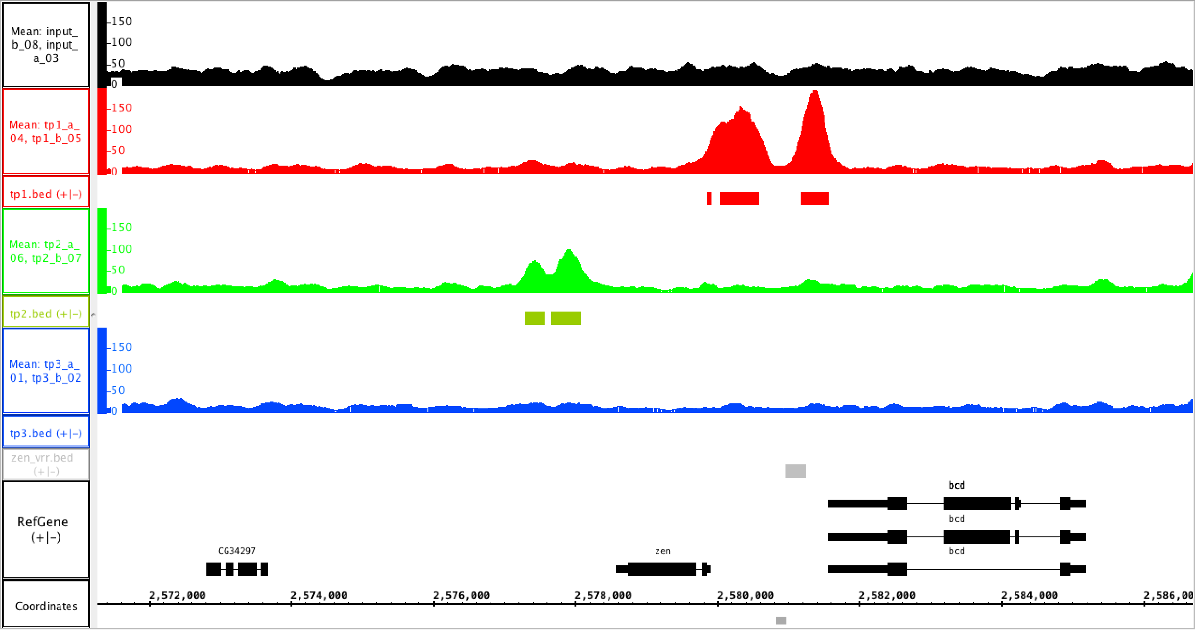
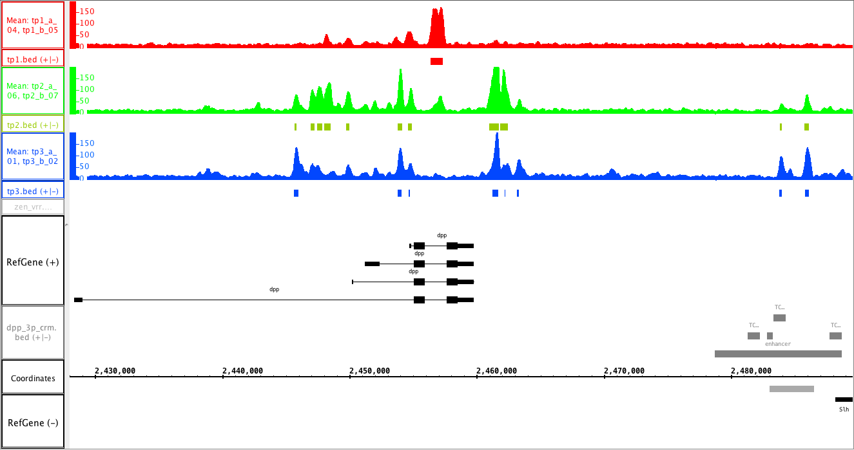
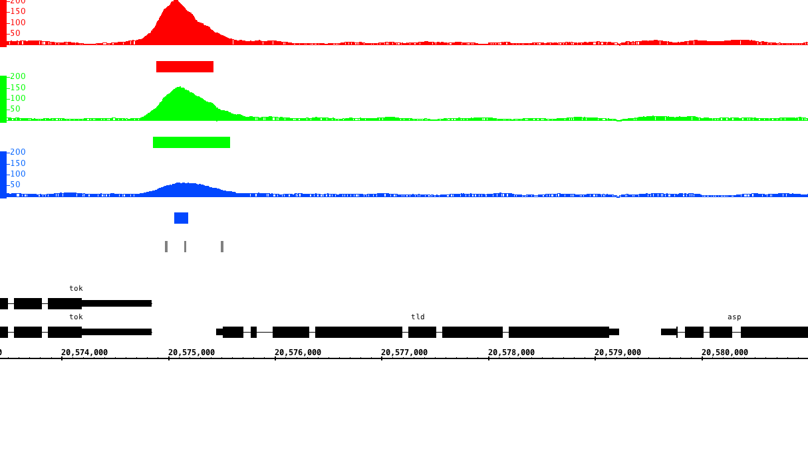
A
1.5 – 4 hr
4 – 6.5 hr
6.5 – 9 hr
VRR
B
1.5 – 4 hr
4 – 6.5 hr
6.5 – 9 hr
C
1.5 – 4 hr
4 – 6.5 hr
6.5 – 9 hr
Dorsal binding sites

Slide 12
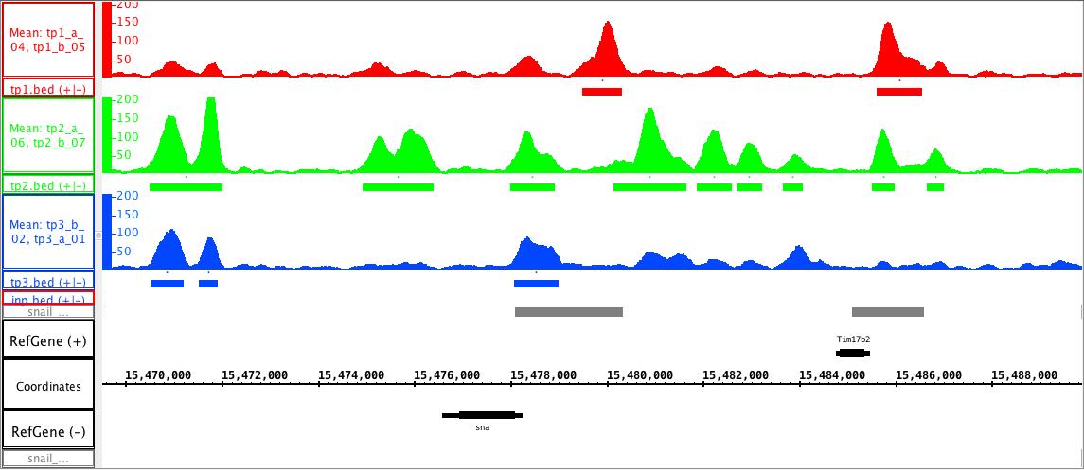
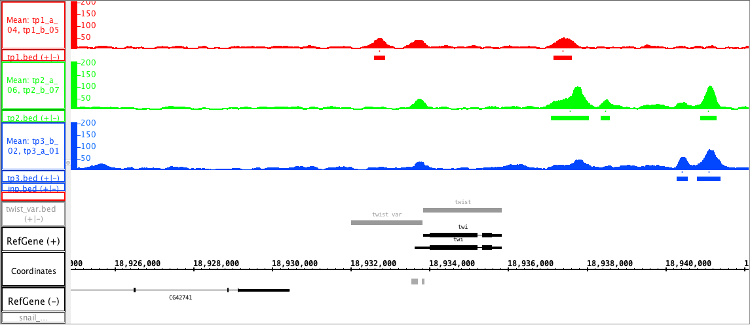
A
1.5 – 4 hr
4 – 6.5 hr
6.5 – 9 hr
primary
shadow
B
1.5 – 4 hr
4 – 6.5 hr
6.5 – 9 hr
VAR

Slide 13
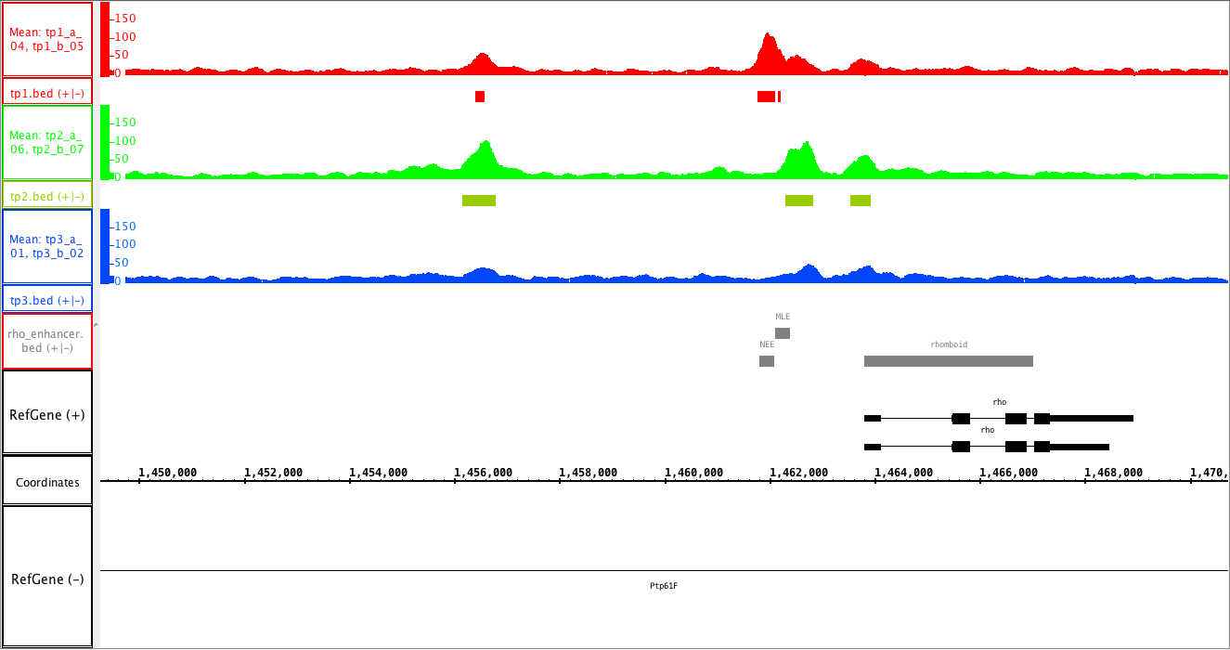
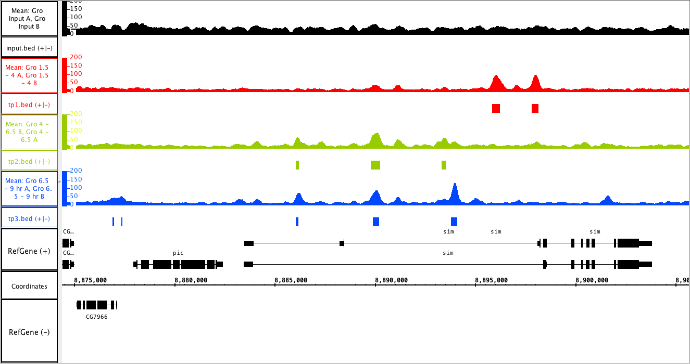
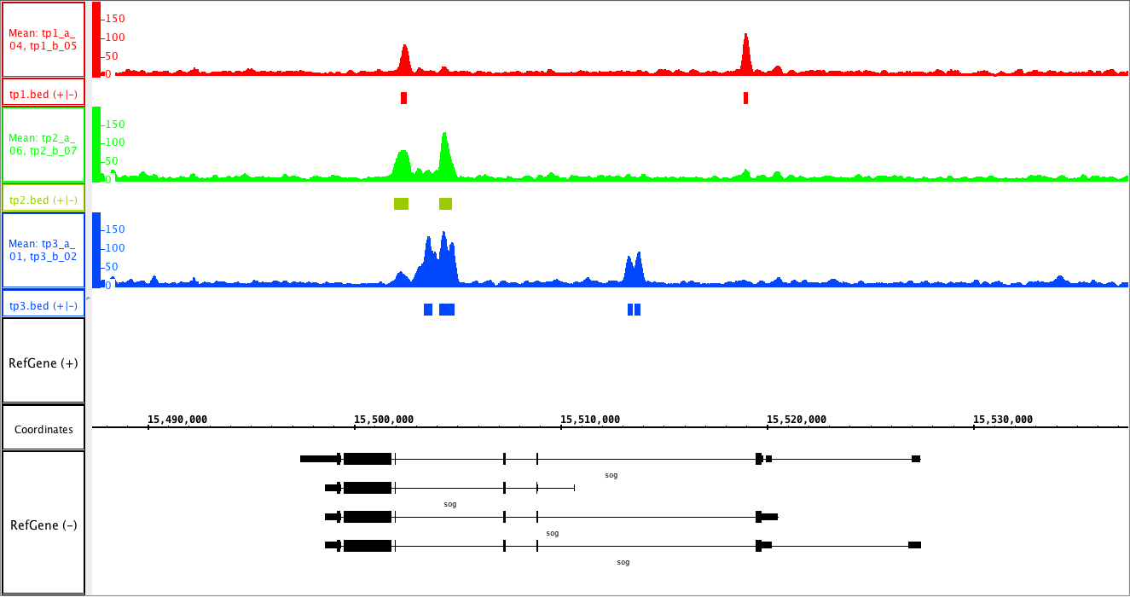
A
1.5 – 4 hr
4 – 6.5 hr
6.5 – 9 hr
NEE
MLE
B
1.5 – 4 hr
4 – 6.5 hr
6.5 – 9 hr
C
1.5 – 4 hr
4 – 6.5 hr
6.5 – 9 hr

Slide 14
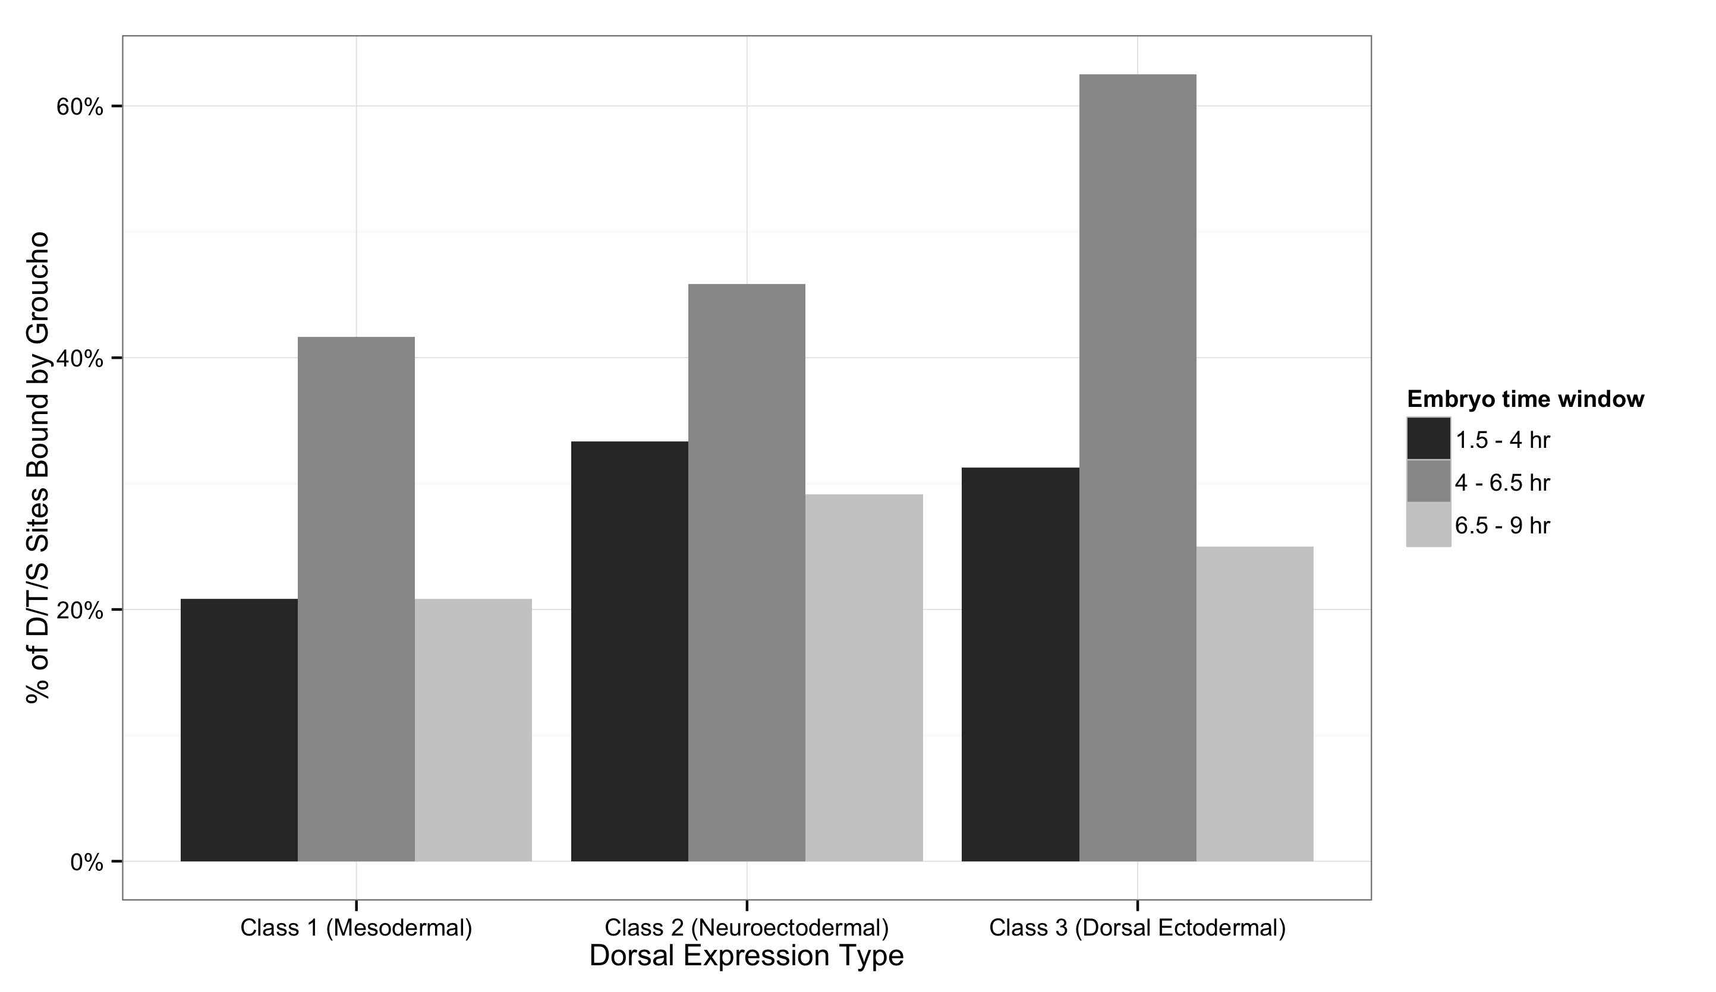
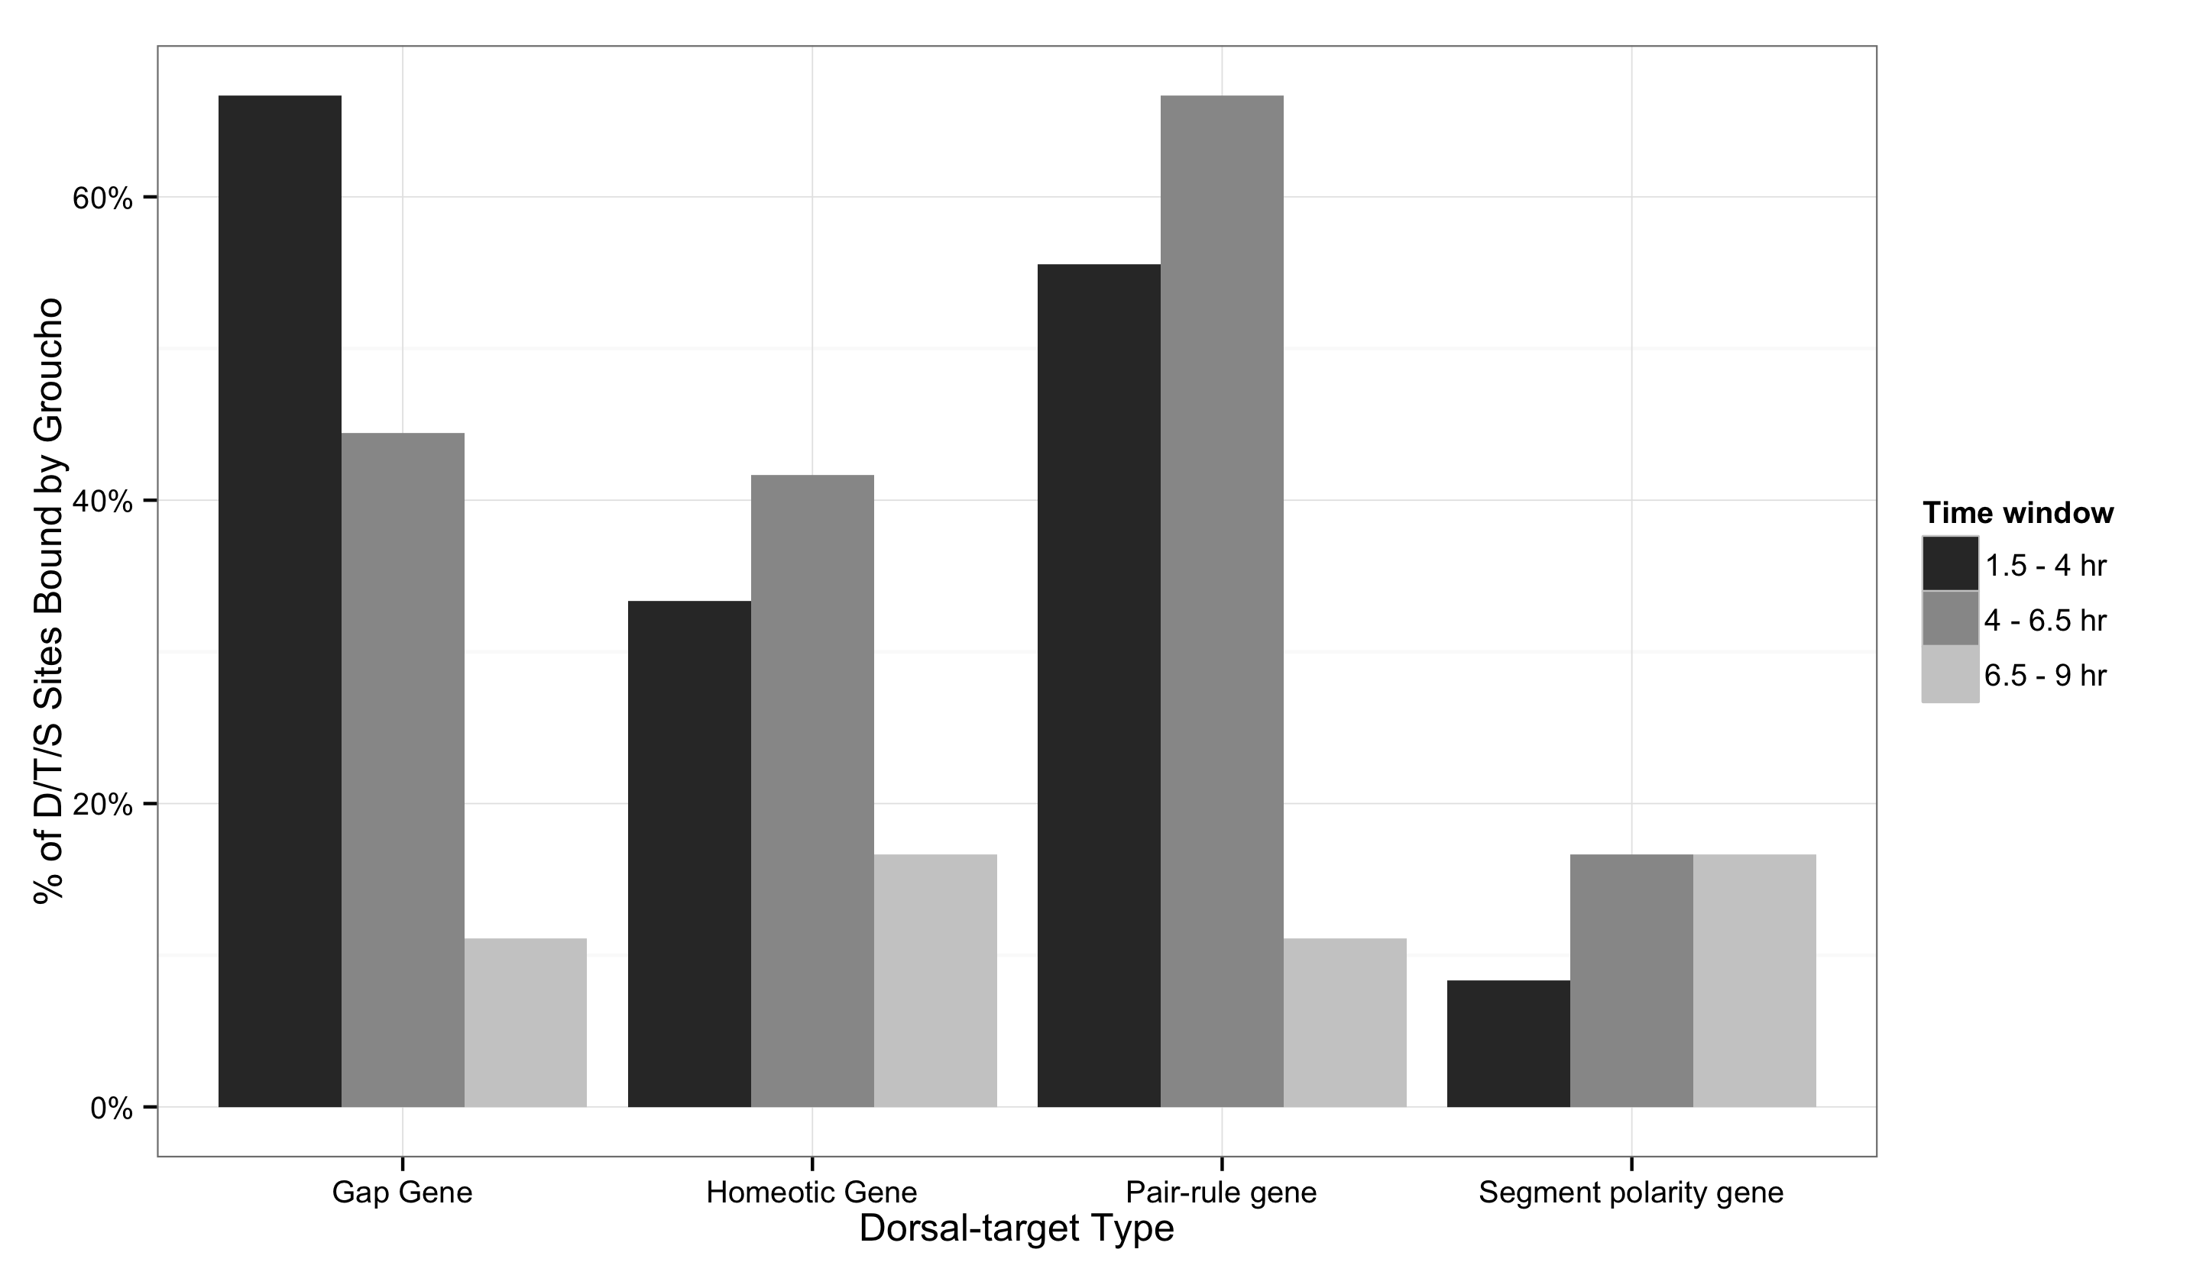
A
B

Slide 15
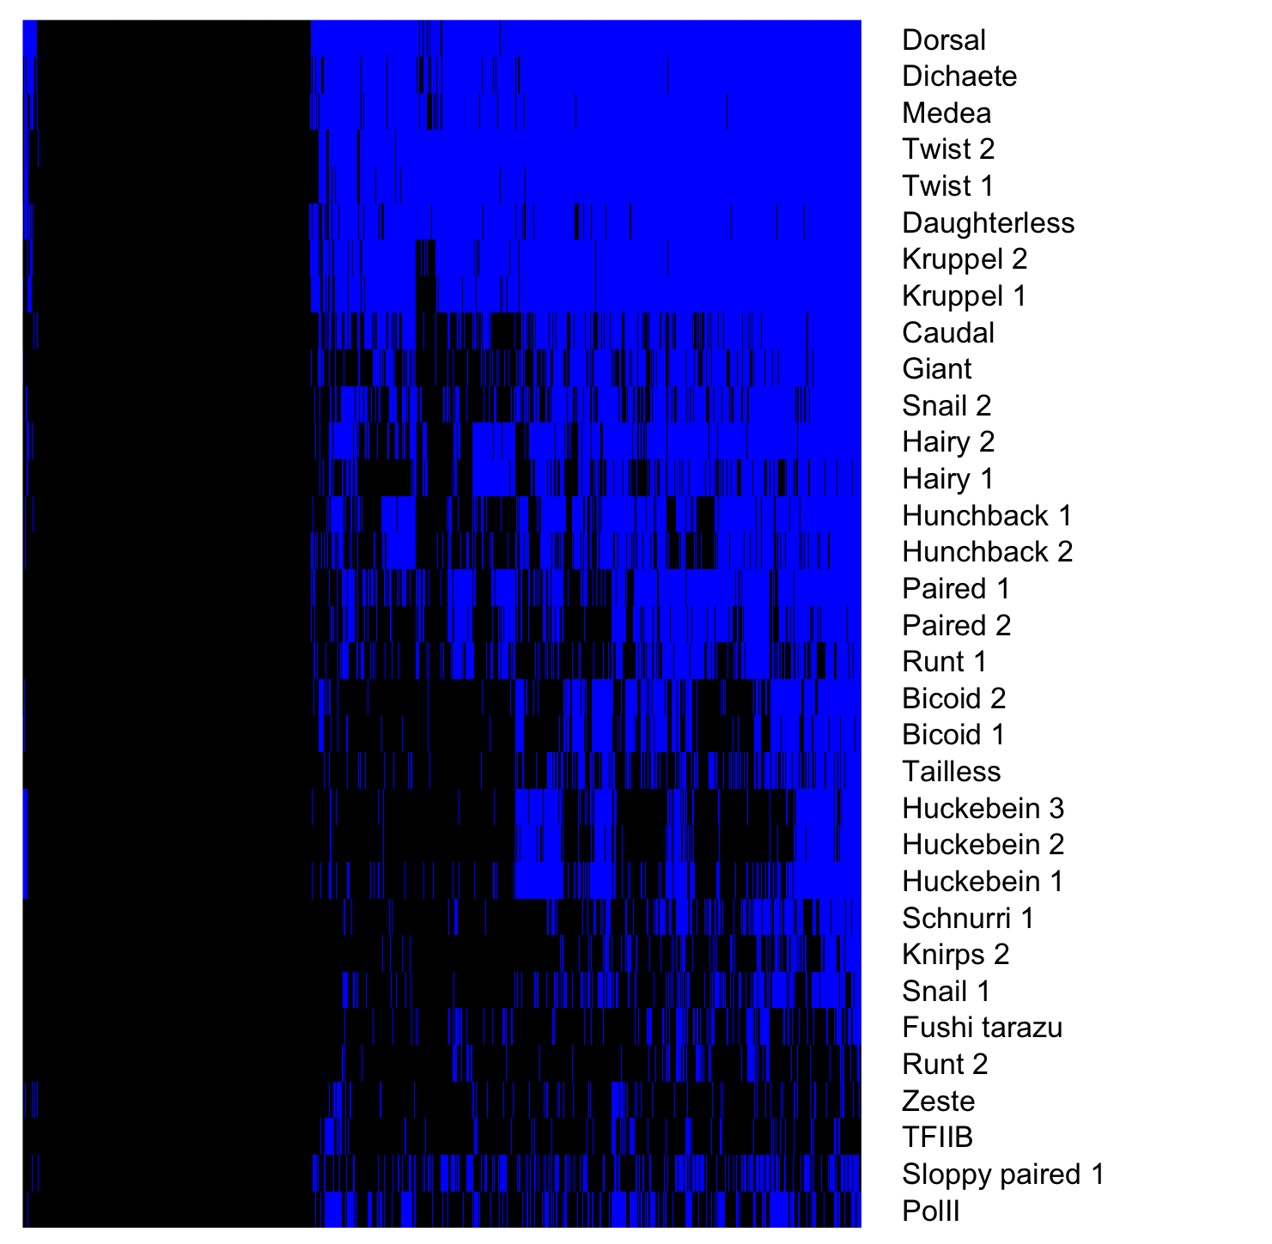
Gro binding sites, 1.5 – 4 hr embryos
Factor occupancy

Slide 16
z-score
Anterior-posterior
*
*
*
*
*
Dorsal-ventral
*
1.5 – 4 hr
4 – 6.5 hr
6.5 - 9 hr

Slide 17
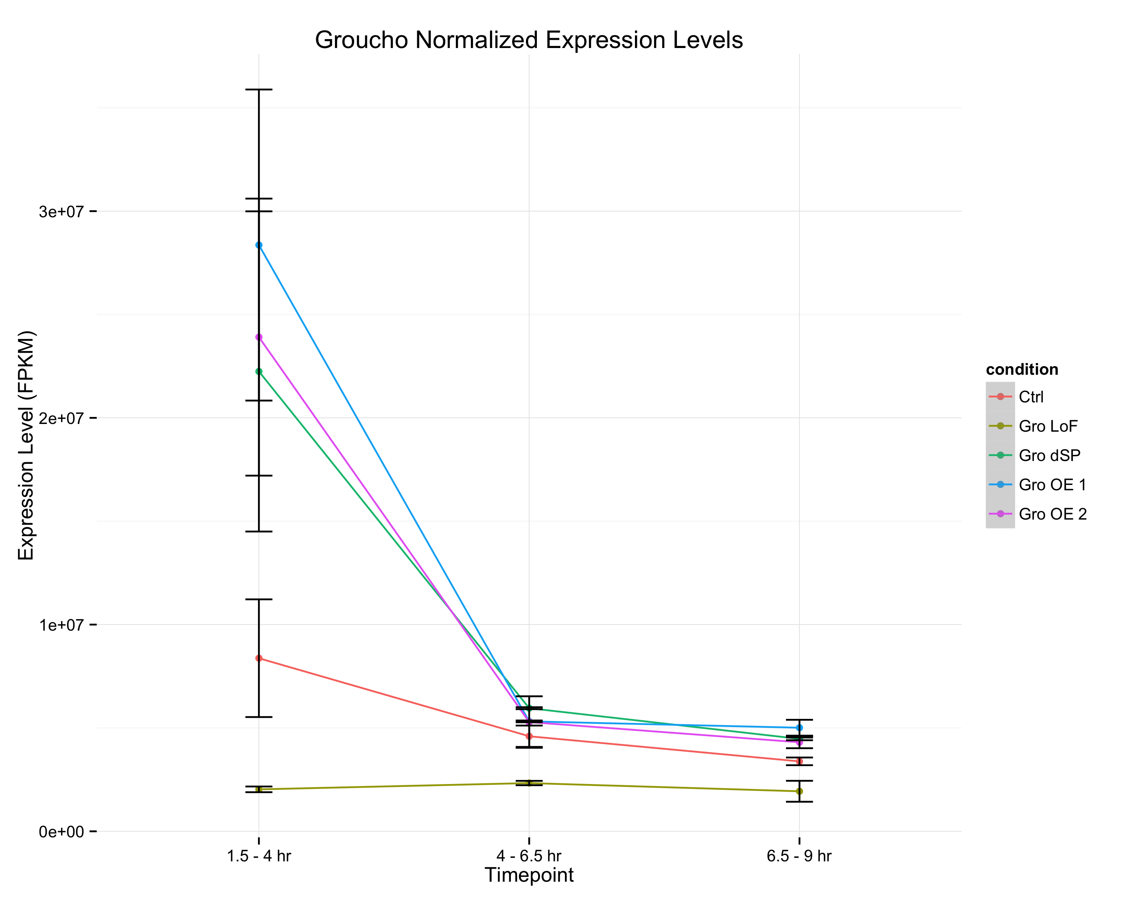
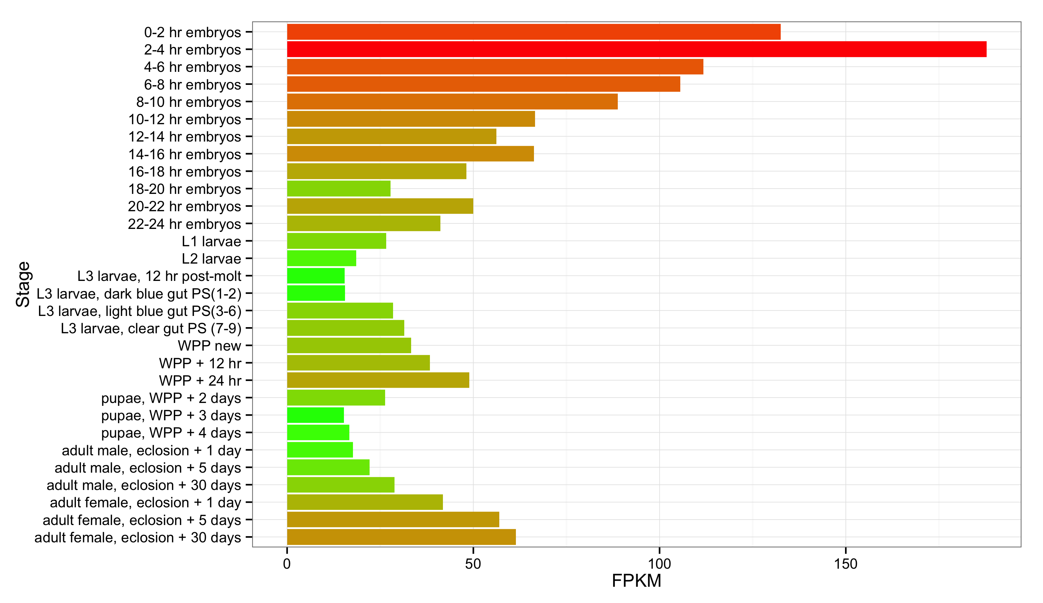
A
wt
Gro^{MB36}
GroΔSP
Gro overexpression 1
Gro Overexpression 2
Groucho transcript abundance
modENCODE Developmental Transcriptome Project
B

Slide 18
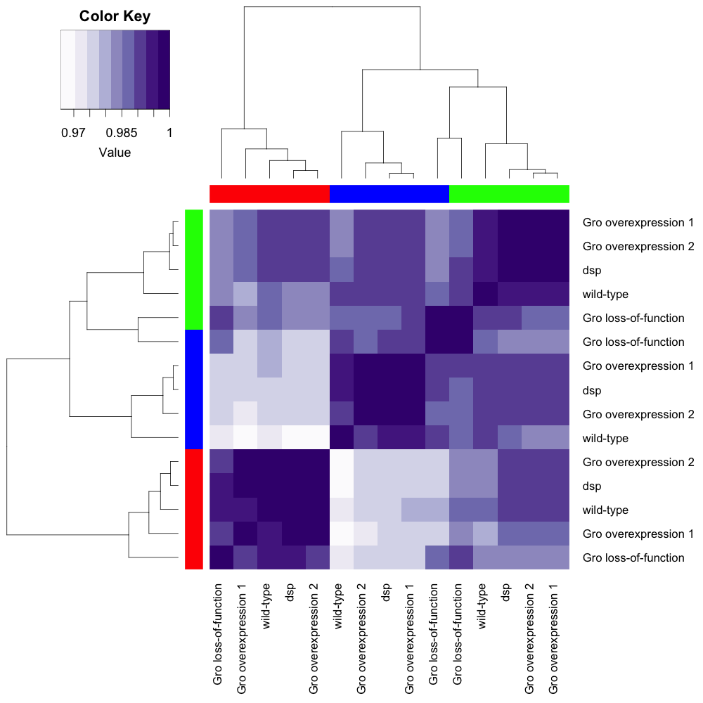
-
- 1
Spearman
coefficient
- 0.9
Embryo
age
1.5 – 4 hr
4 – 6.5
6.5 – 9
GroΔSP
GroΔSP
GroΔSP
GroΔSP
GroΔSP
GroΔSP

Slide 19
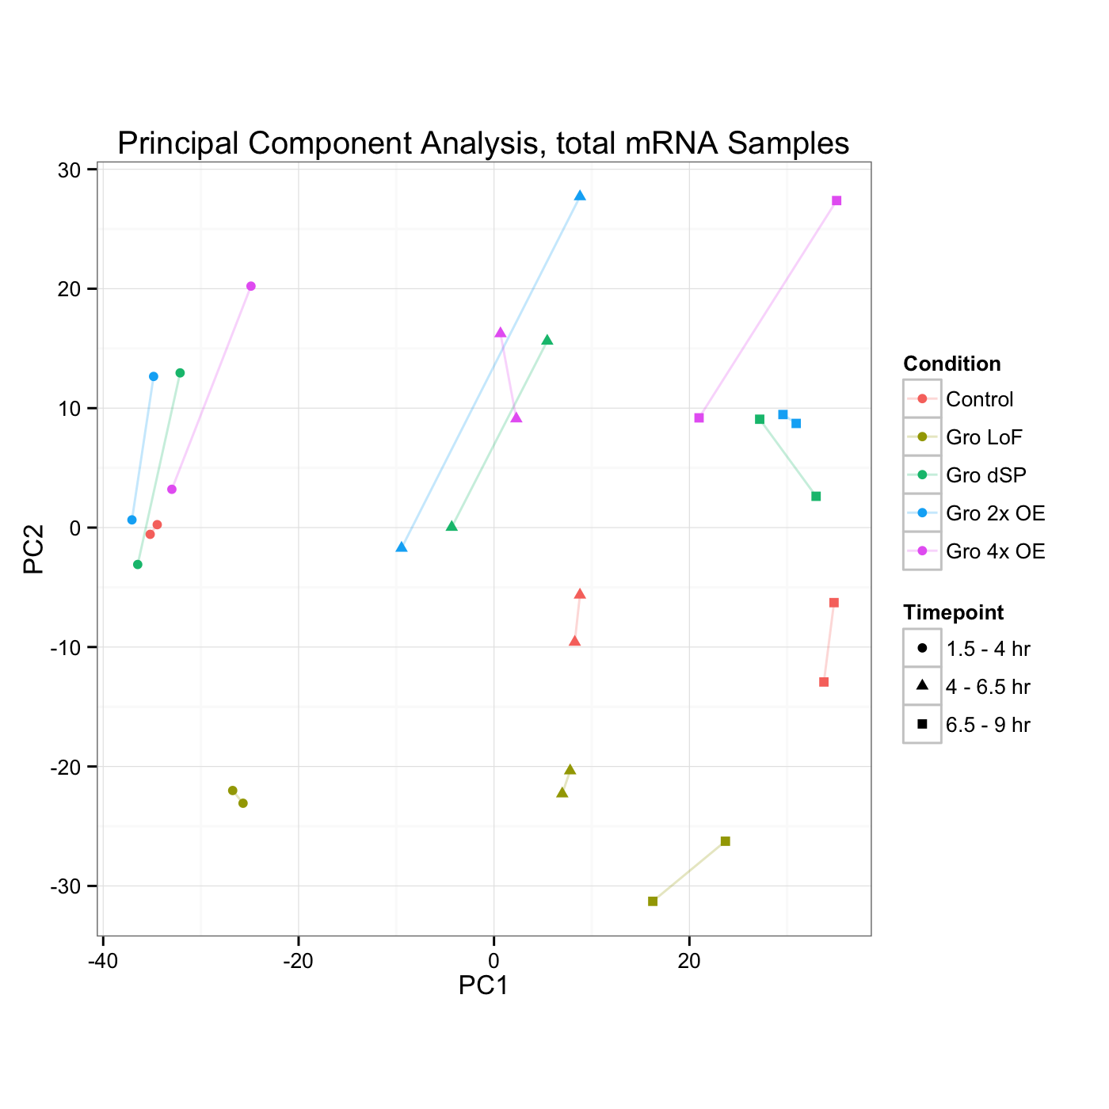
Gro Dosage
Developmental Stage

Slide 20
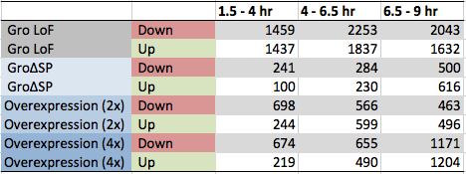
A
B

Slide 21
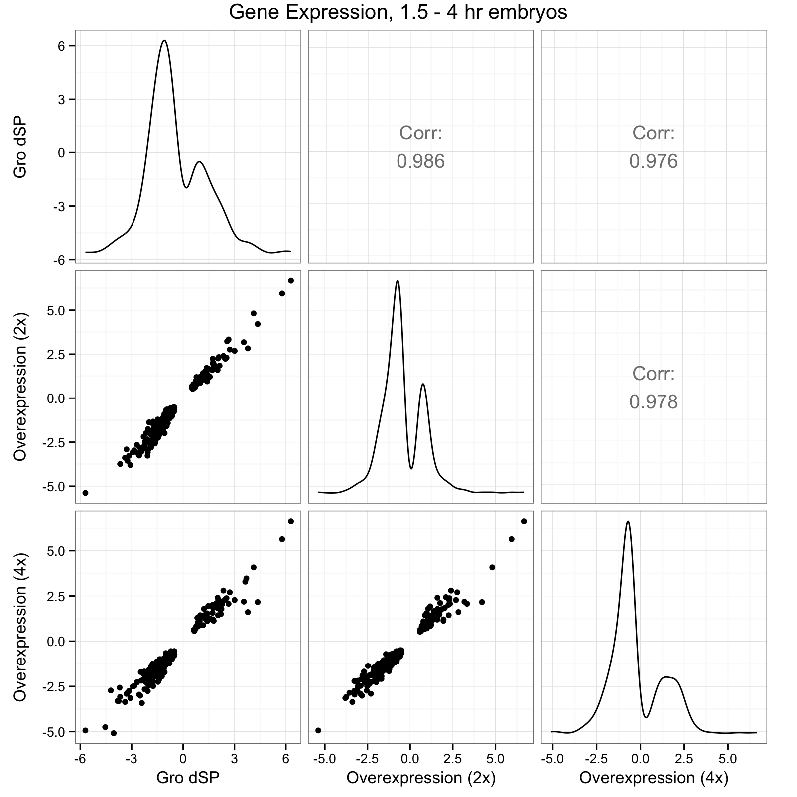
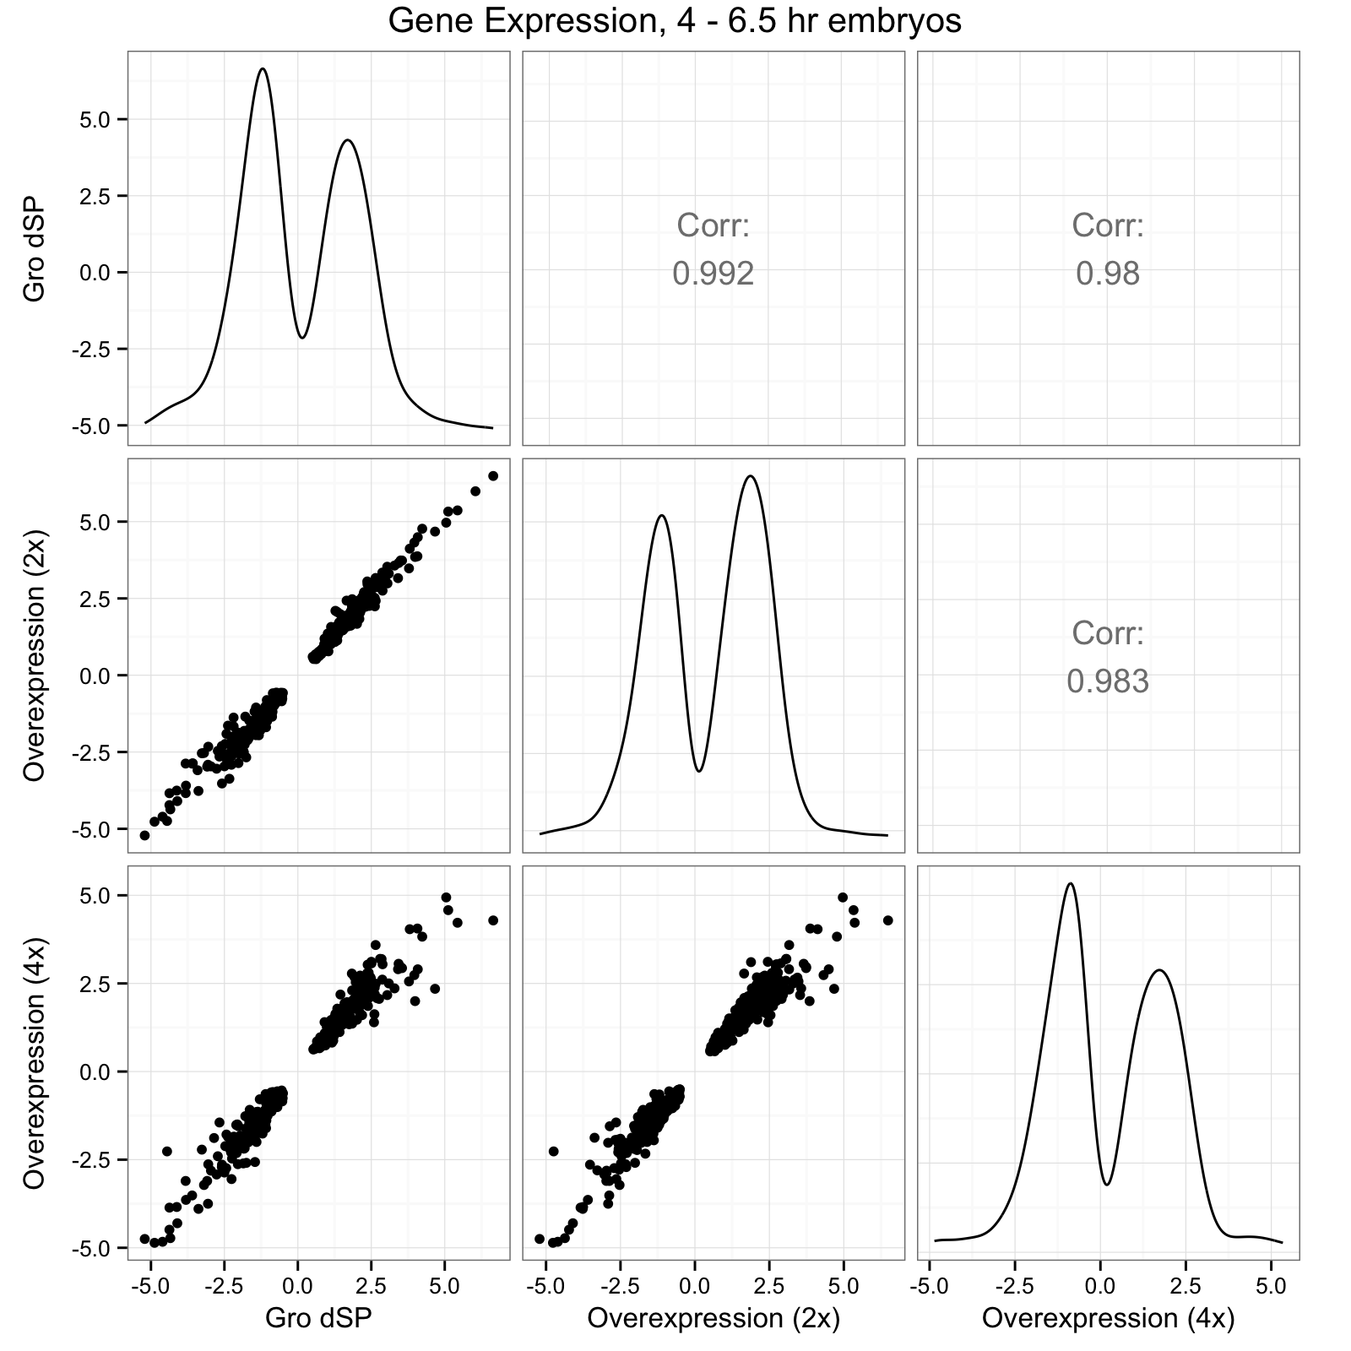
A
B

Slide 22
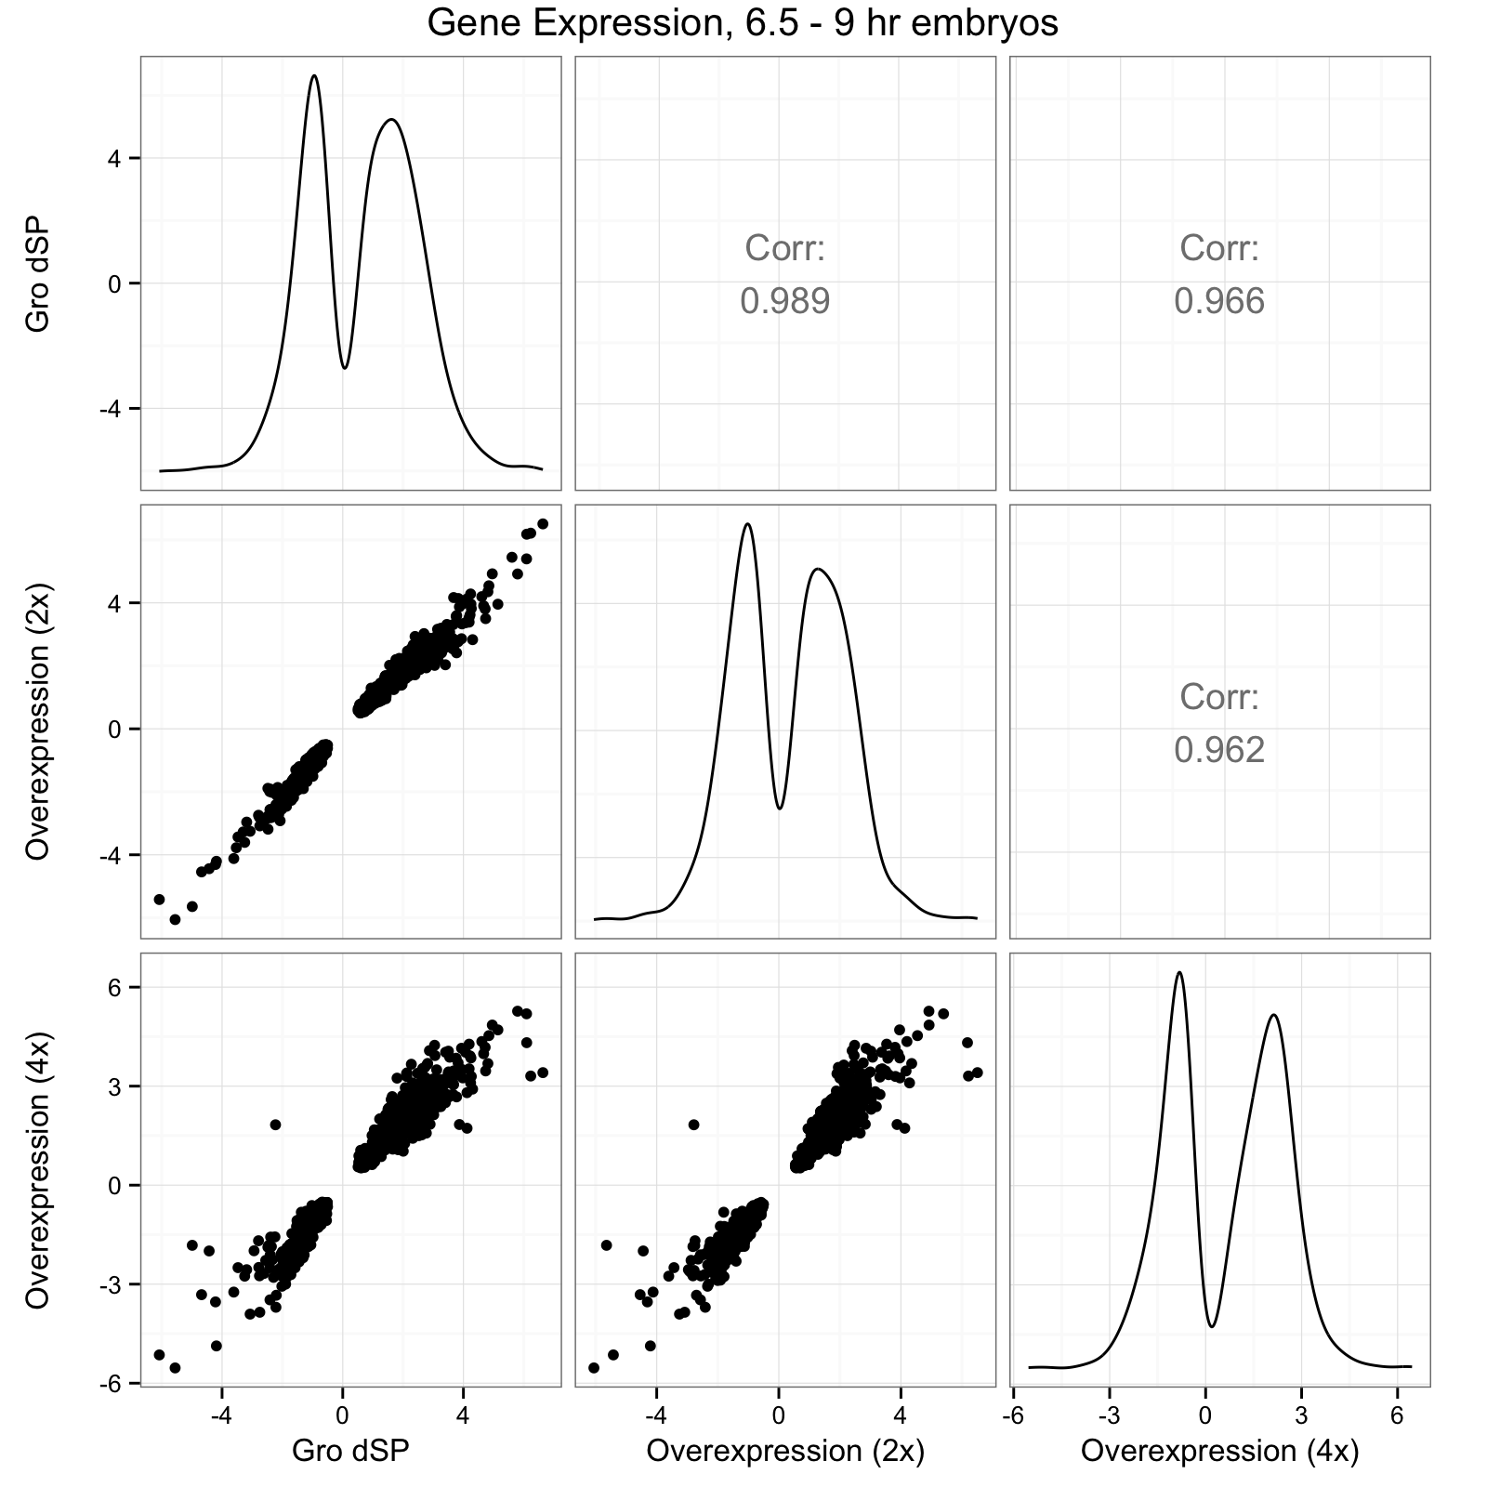
C

Slide 23
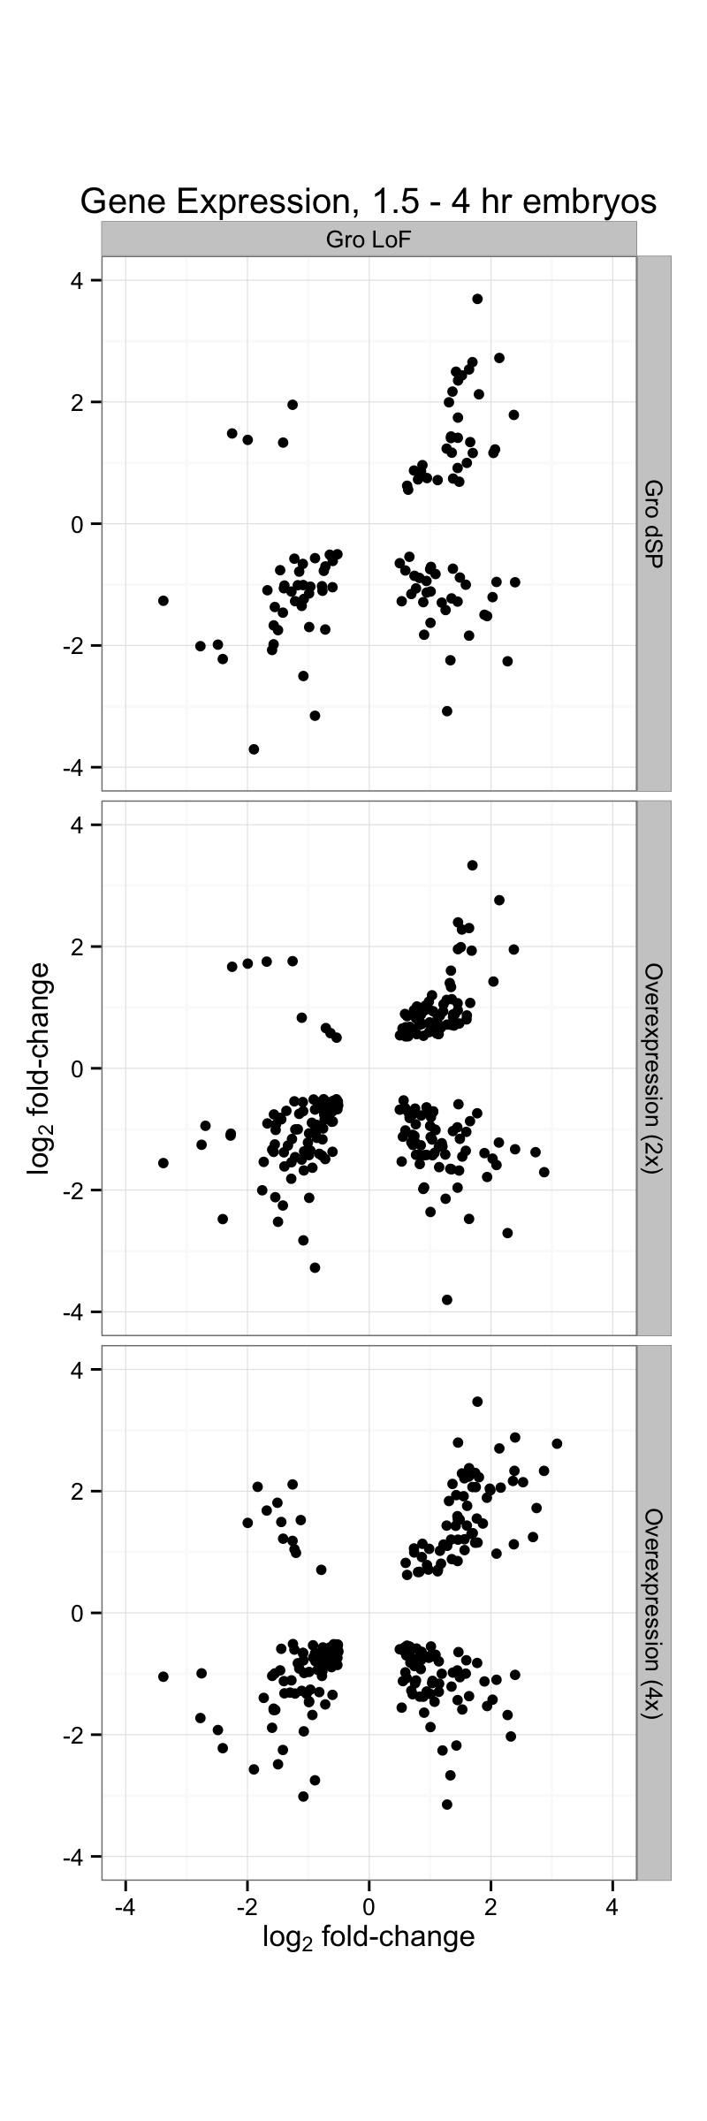
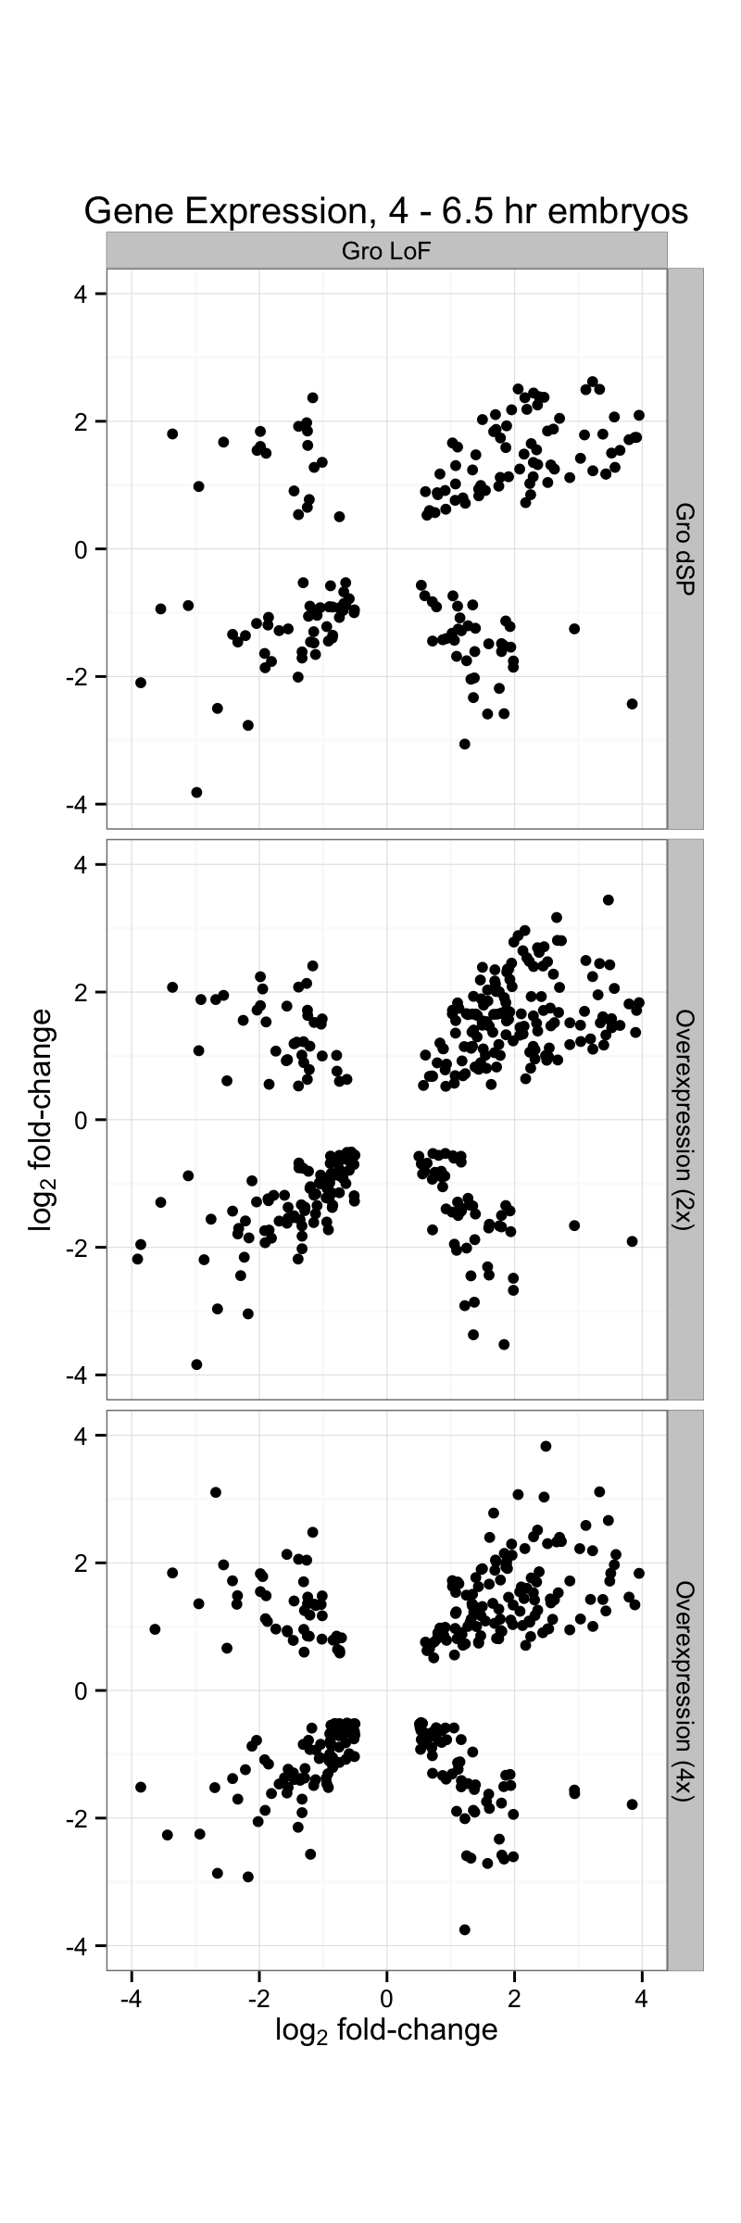
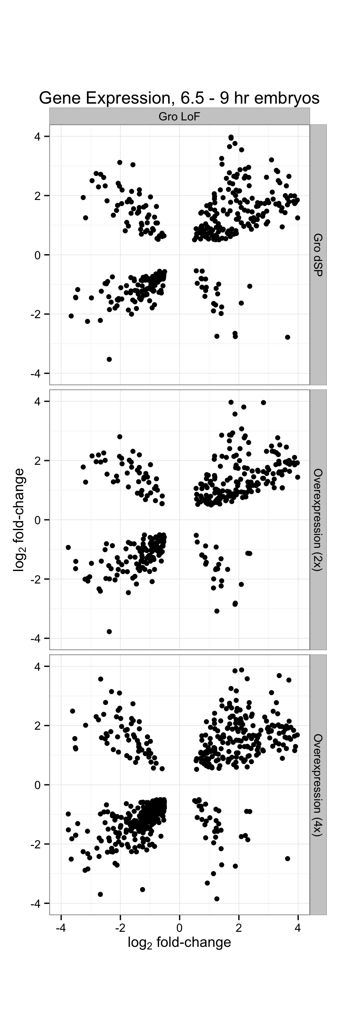

Slide 24
Gro loss-of-function
vs.
2x Gro Overexpression
Gro loss-of-function
vs.
4x Gro Overexpression

Slide 25
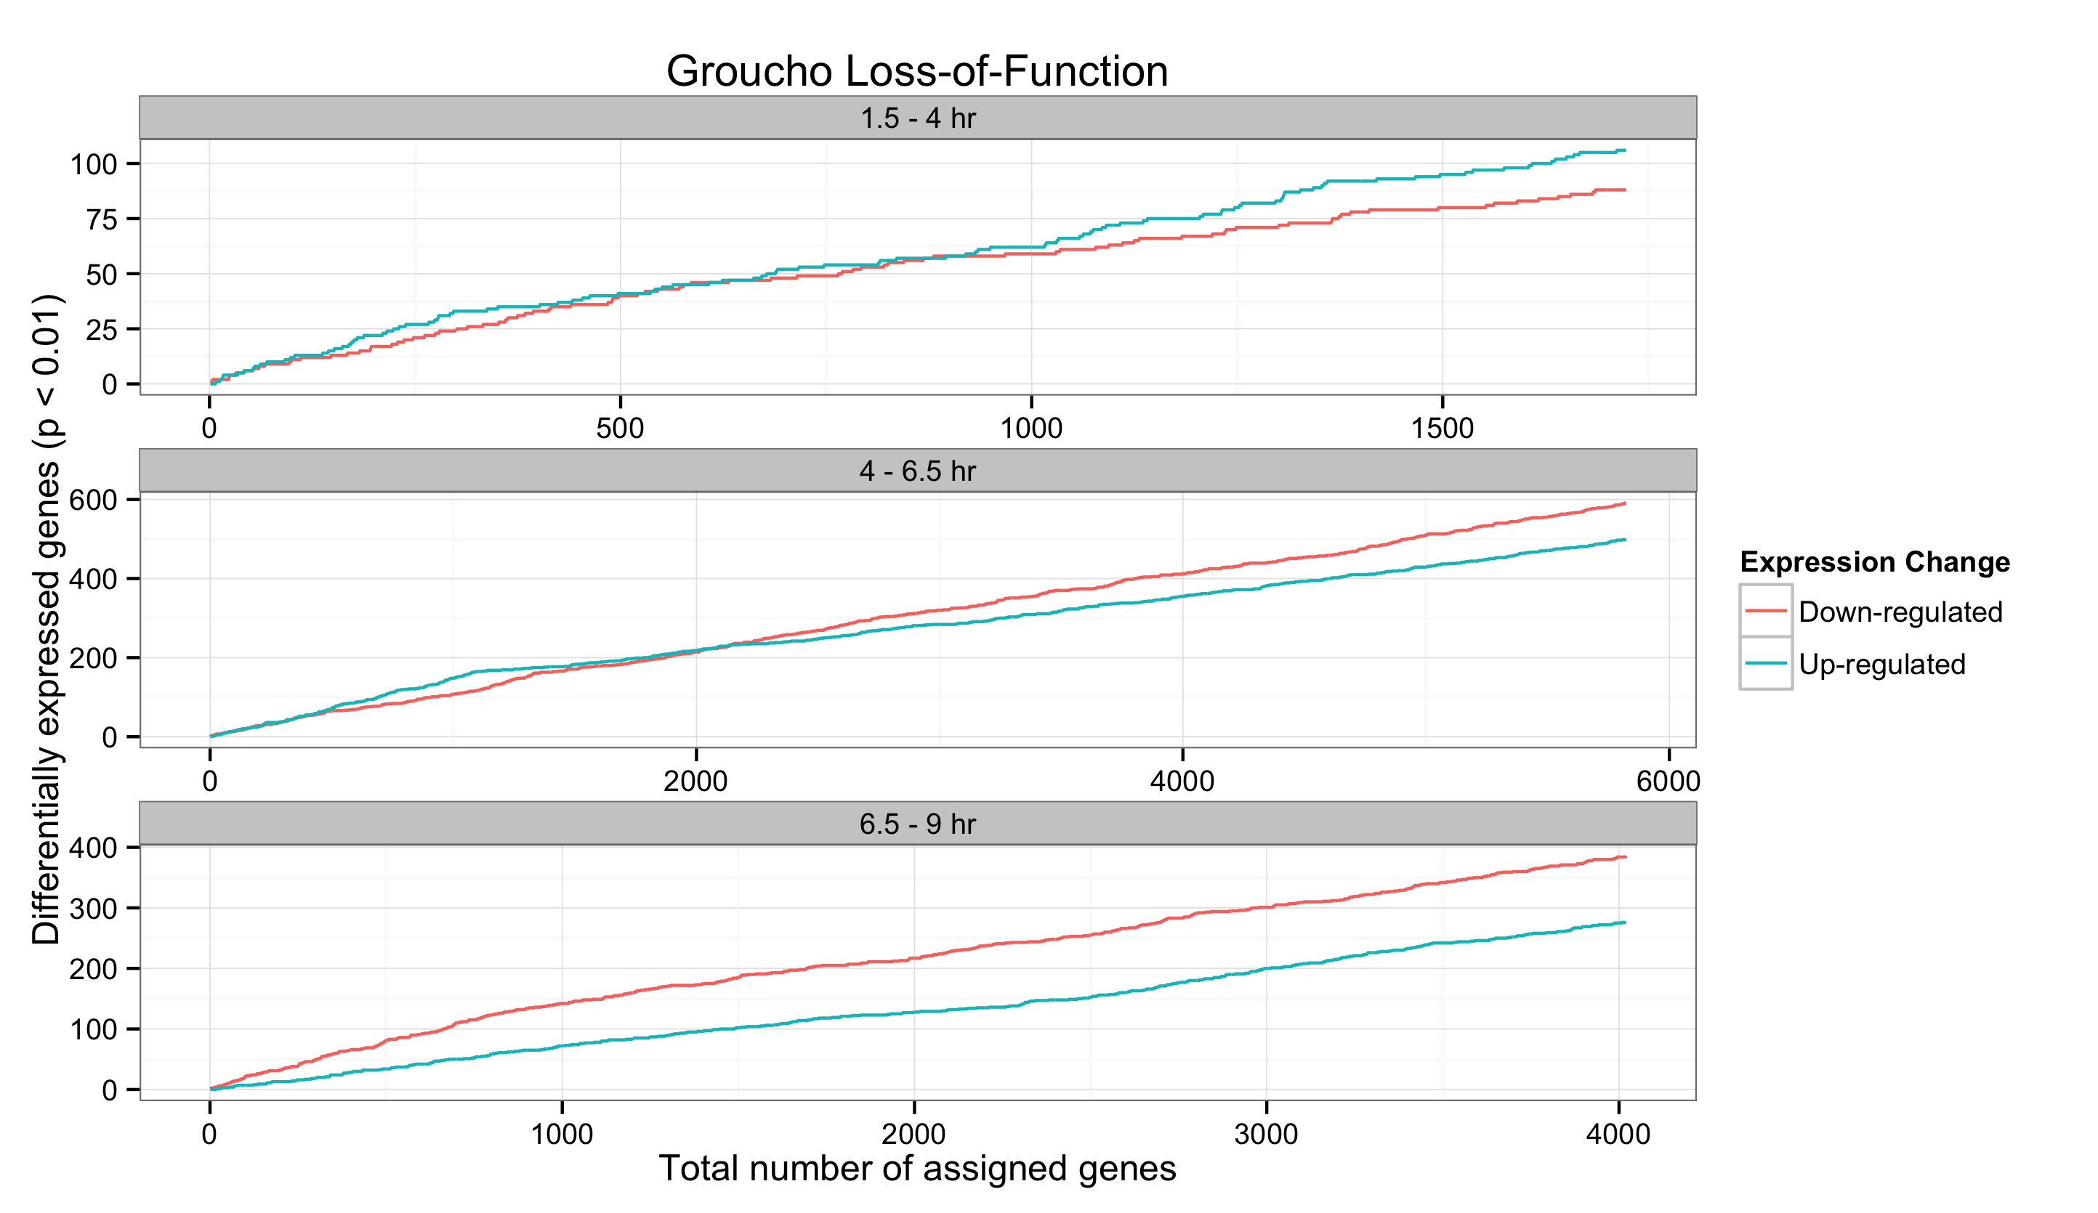
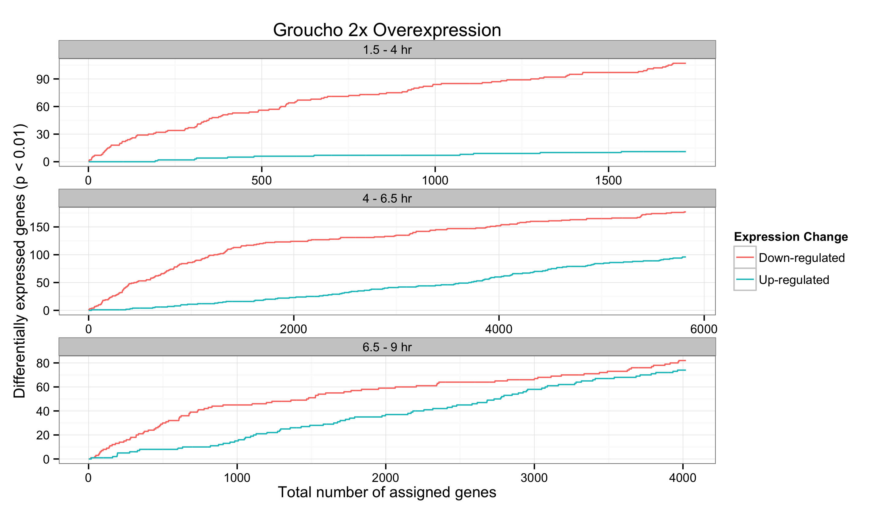
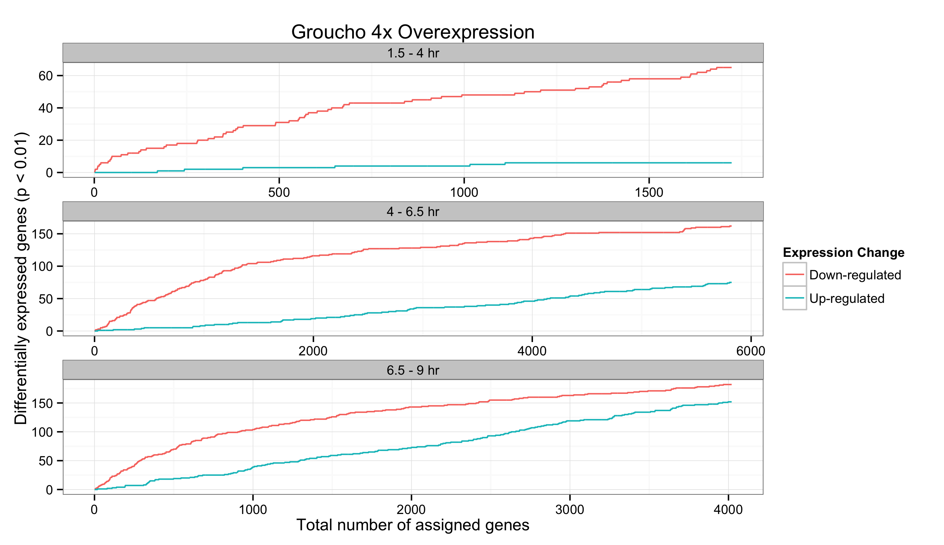
A
B
C

Slide 26
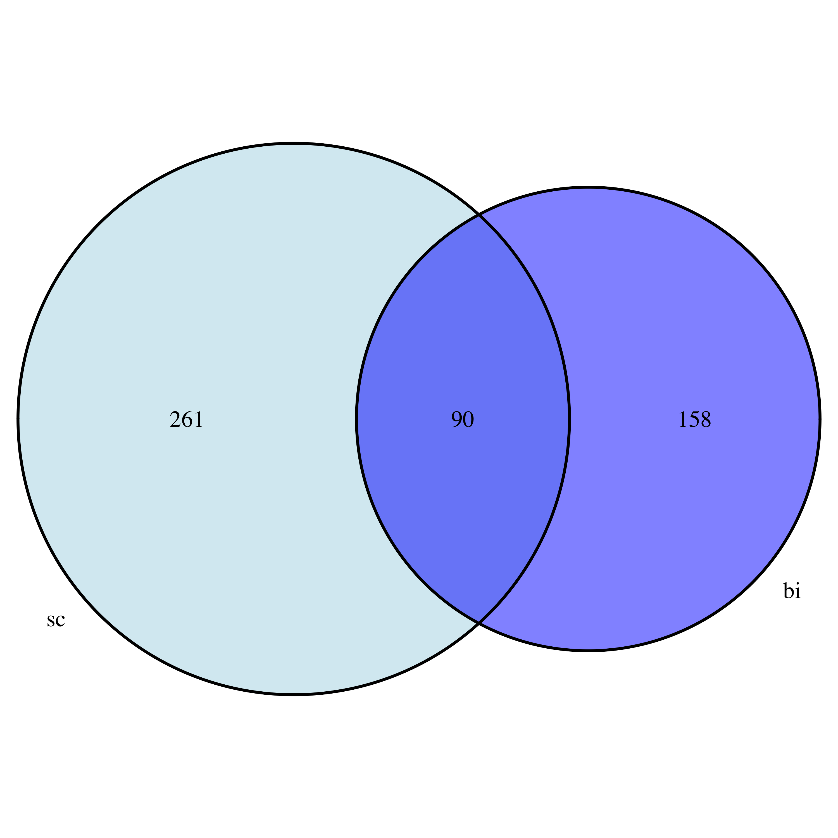
Genes above Groucho occupancy
score cutoff
Groucho Dosage Sensitive
And
Groucho Bound Genes

Slide 27
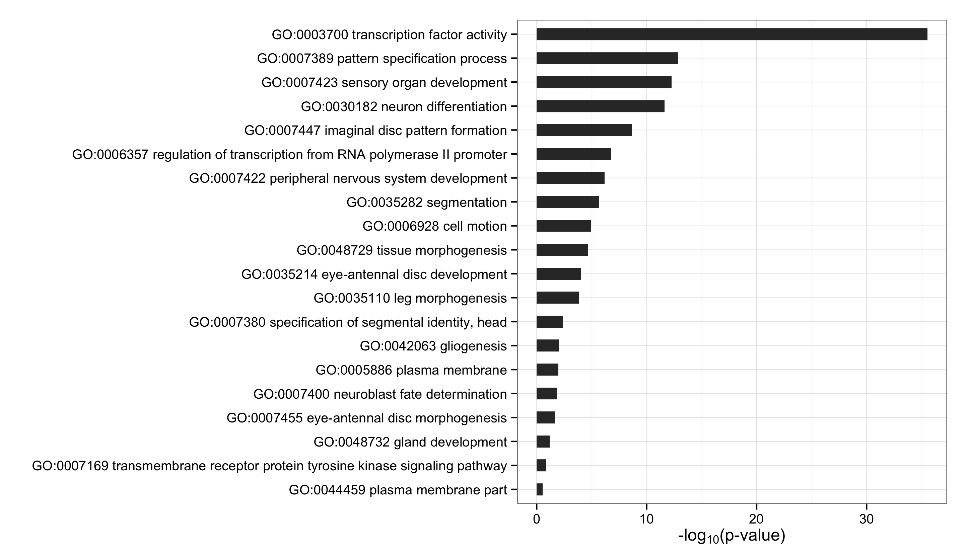
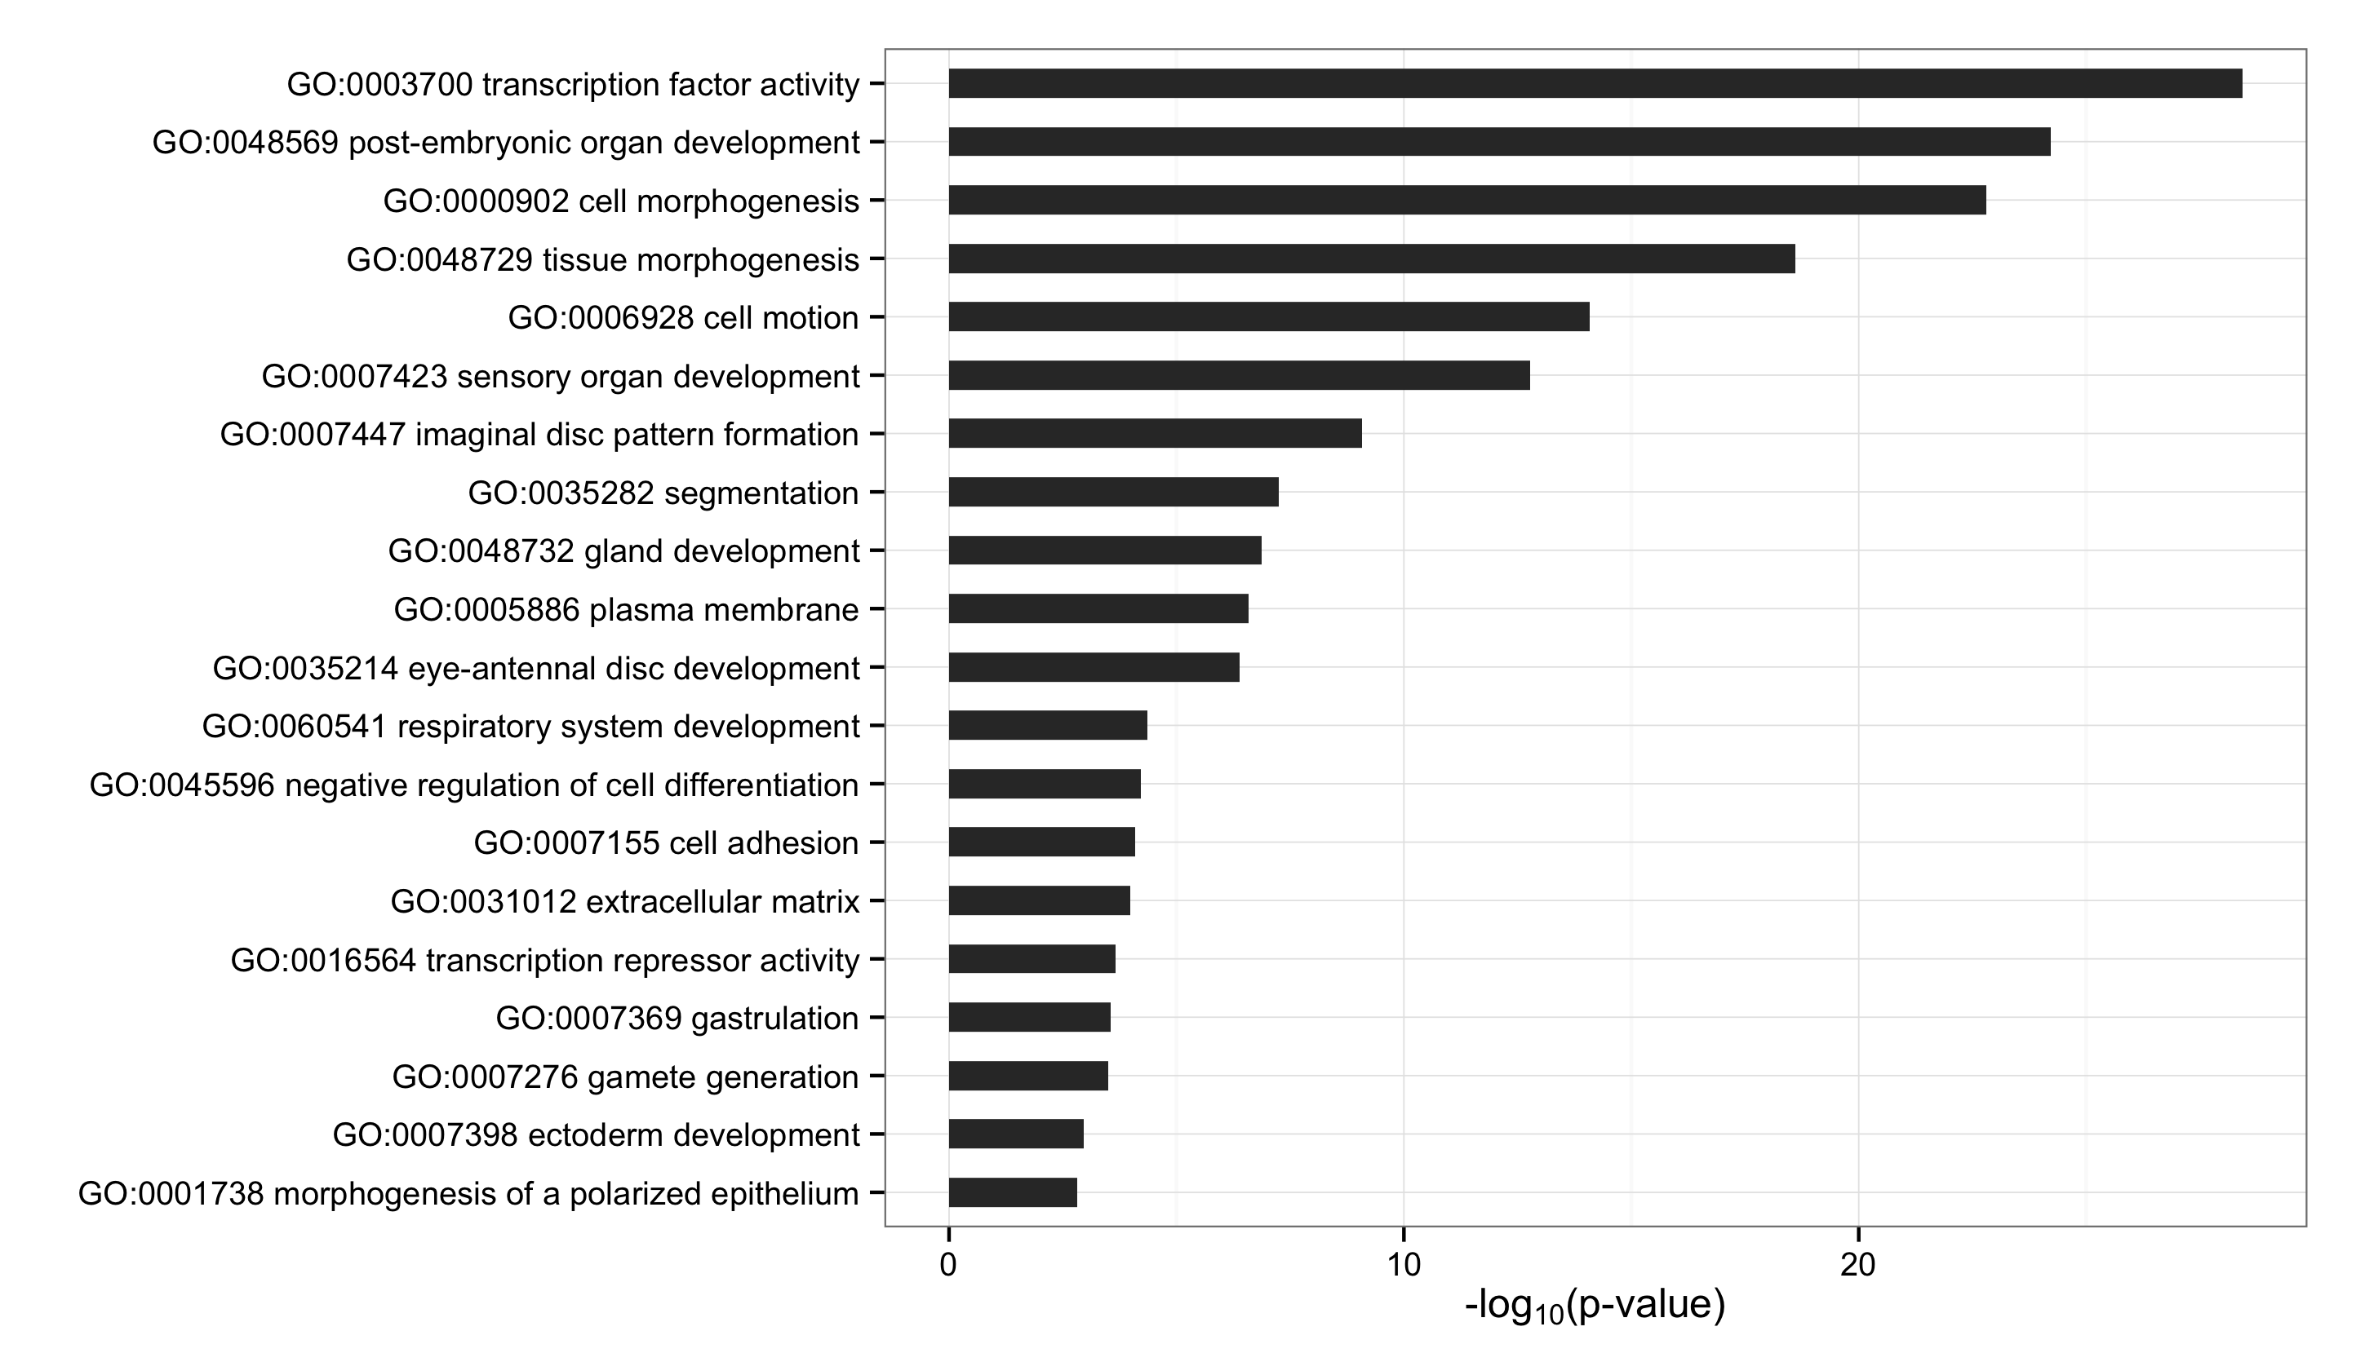
A
Gro Targets by Dosage Response
B
Gro Targets by Occupancy Score

Slide 28
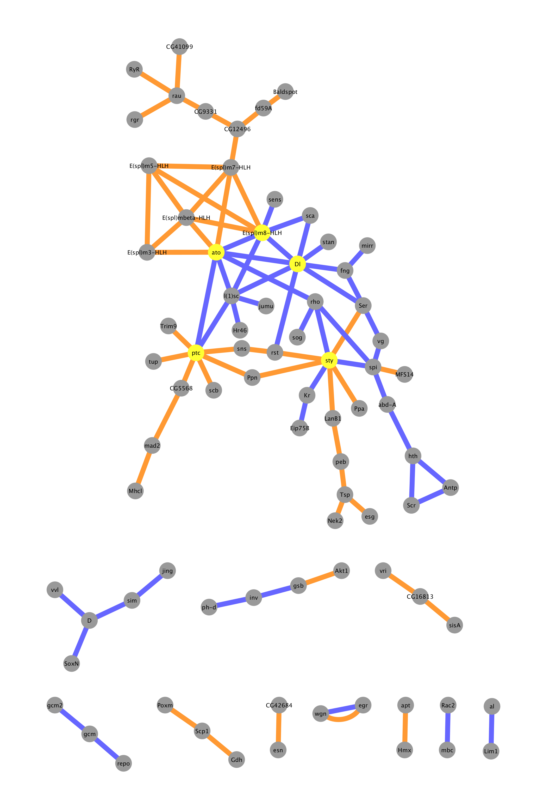
A
Gro Targets by Dosage Response
Physical interaction
Genetic interaction

Slide 29
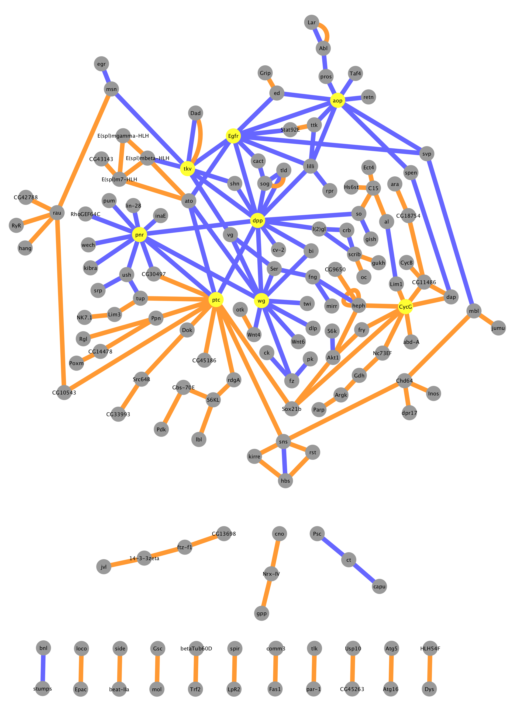
B
Gro Targets by Occupancy Score
Physical interaction
Genetic interaction

